Slide 1
Peer Structures
Teaching and Learning Resources
to Prevent Identity-based Bullying
LESSON THREE:

Slide 2
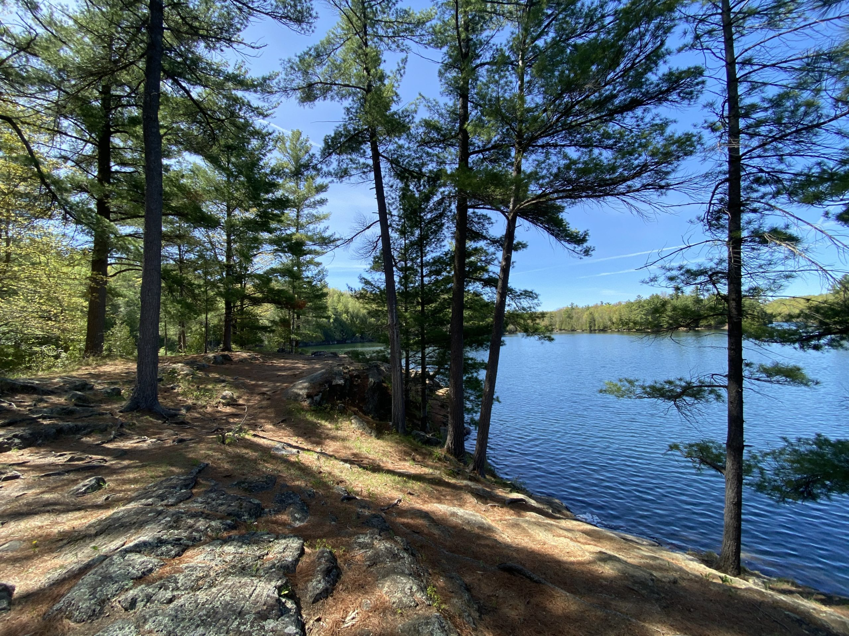
Land Acknowledgement

Slide 3
Identity-Based Bullying
Bullying that targets people based on their identities.
Notes:
Identity-based bullying [CLICK] targets people based on their identities. People’s identities include many things, such as body size, race, ethnicity, nationality/newcomer status, gender, sexual orientation, class, or ability, among others.
So, identity-based bullying may look like repeatedly targeting someone by calling them hurtful names because they are gay, excluding someone because they are of a different race, catcalling someone because they’re a girl, making a hurtful social media post about someone based on their physical appearance, or making fun of someone because they are in a wheelchair.

Slide 4
Identity-based Bullying
Power imbalance
Power = ability to impact lives of others
Created by society
Notes:
Identity-based bullying occurs [CLICK] when there are differences in power between the person (or group of people) bullying and the person being bullied.
Bullying happens when there is a difference in power between two people or a group of people. Someone has power [CLICK] when they have the ability to act in ways that can impact the lives of others.
The differences in power that are at the root of identity-based bullying have been [CLICK] created by society, by oppressing some groups and privileging others over time. As a result, some groups in society continue to have more power as compared to others (for example, heterosexual youth hold more social power than queer youth, because society gives more social power to heterosexual people).

Slide 5
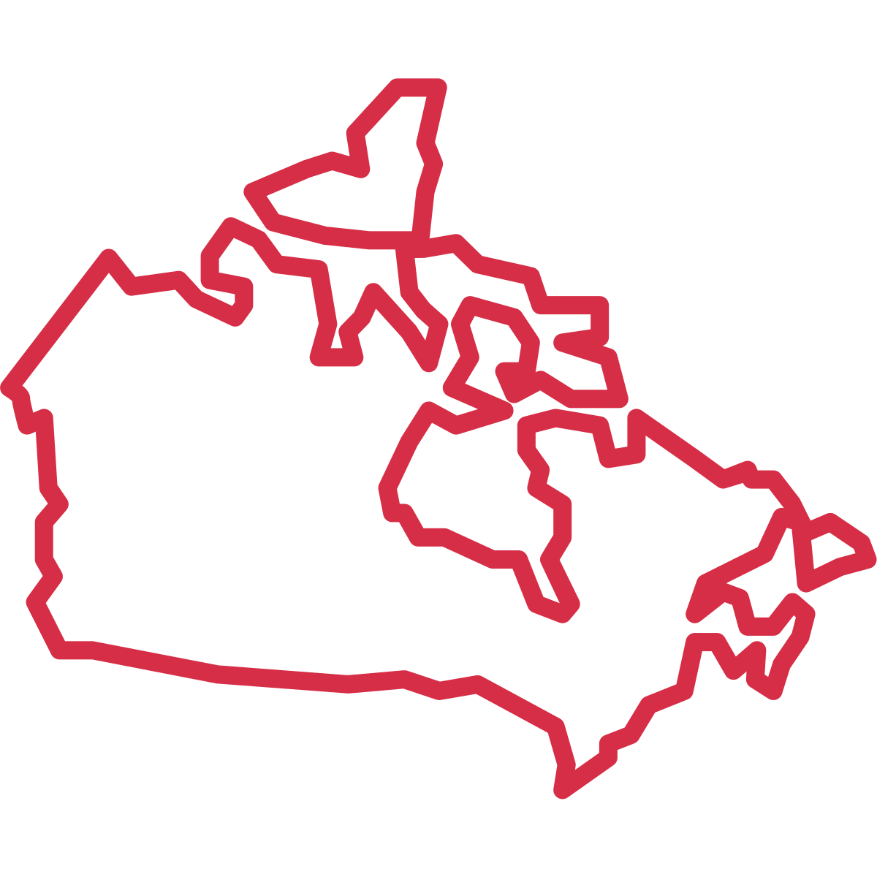
Notes:
Because of these larger social beliefs, everyone in Canada is exposed to ideas (both passively and actively) that groups who do not make up the dominant culture are ‘different’, and that these differences mean that these groups are worth less than the dominant group.

Slide 6
Who has power in Canada?
Notes:
In Canada, examples of dominant groups who have more power include White people, heterosexual people, cisgender people, able-bodied people, Christian people, thin people, and people with more financial resources.

Slide 7
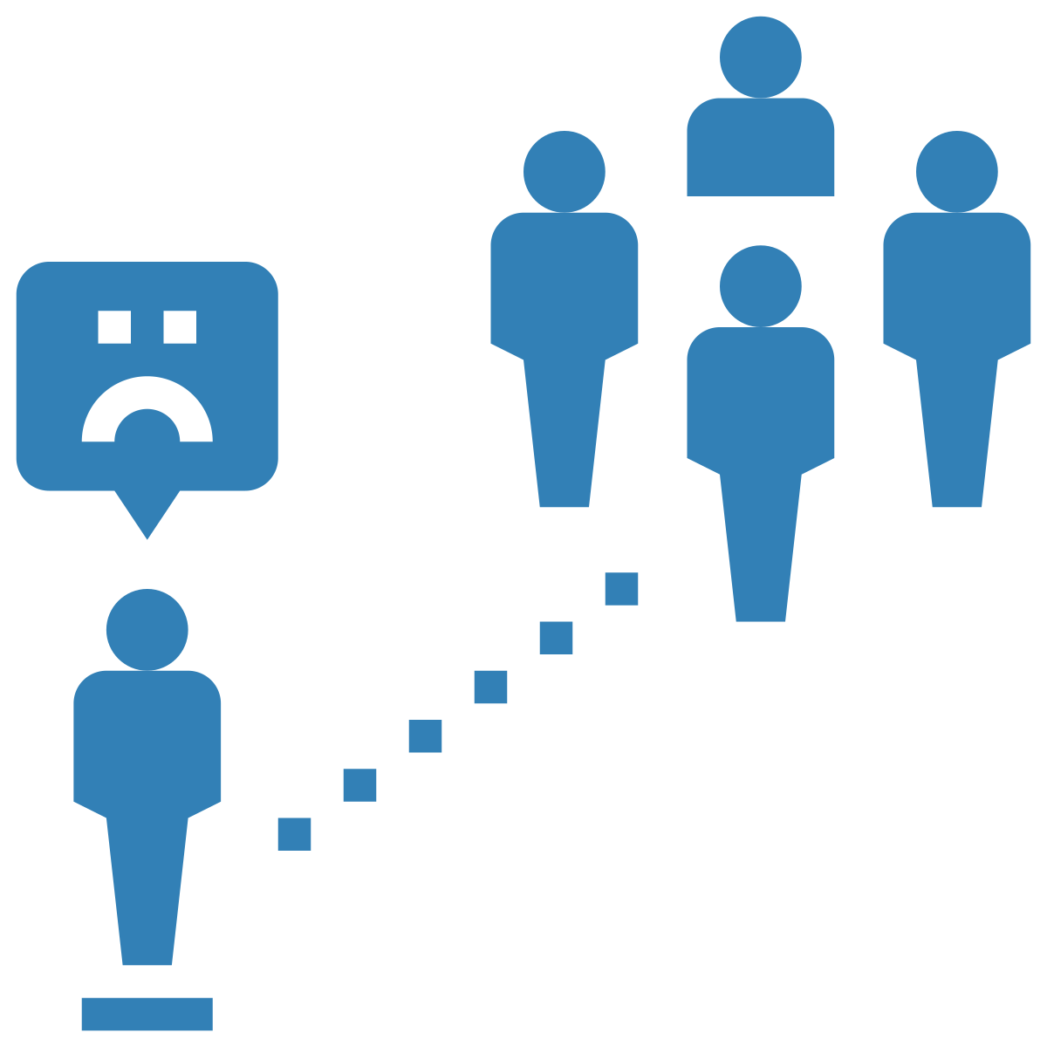
Interpersonal Level
Notes:
Because of these power differences, people who are perceived as different from the dominant groups in society face stigma and discrimination. [CLICK] This stigma and discrimination is something people experience at the interpersonal level.

Slide 8
Institutional and Societal Level
Notes:
At the institutional and societal level, these power differences result in lack of equitable access to resources and opportunities.

Slide 9
Notes:
For example, physically disabled youth are often treated as less competent as compared to youth without a disability. This difference in treatment is due to larger social beliefs about what bodies ‘should’ be able to do (something called ableism), and not because of anything to do with individual youth.
Of course, these beliefs are not true, but because of stigma, physically disabled youth are often ignored and excluded, in ways that their able-bodied peers are not. For example [CLICK], we may not provide the resources they need to move about the school independently (such as ramps).
This inequitable treatment (whether done consciously or unconsciously) creates an unhealthy power dynamic where physically disabled youth hold less power as compared to youth without a disability. This differential treatment is wrong and problematic, as identity-based bullying occurs when there is a power imbalance, such that those with more power target those with less power. In this case, a youth who is able-bodied (i.e., who holds more social power) may bully a disabled youth (who holds less social power).

Slide 10
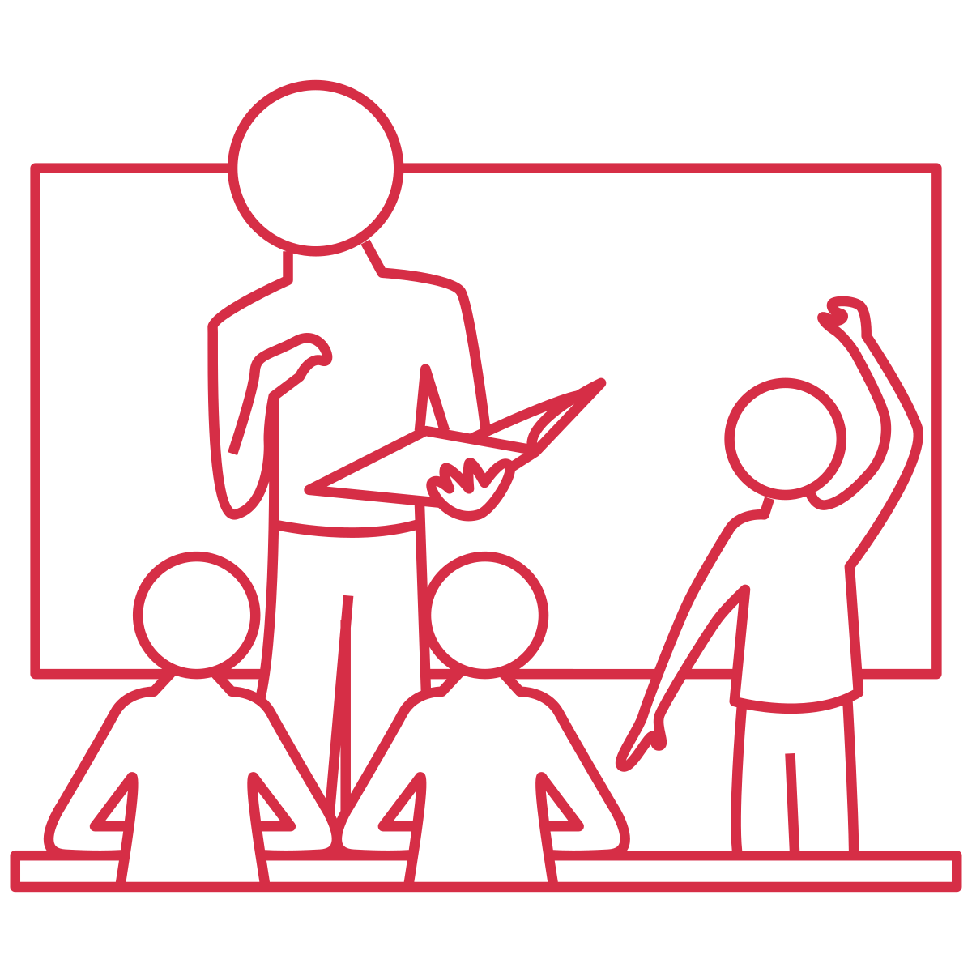
Notes:
But, not all people use their power in negative ways. As educators, we have the ability to notice when and where unhealthy power dynamics exist. When we see unhealthy power dynamics, we can then intervene to create change and contribute to creating an inclusive school climate.
In this video, we’ll talk about how to identify the unhealthy use of power, and how to address when power imbalances are used in unhealthy ways between students in your classroom and the school at large.

Slide 11
Observing Power Dynamics
Children select friends who are like them.
Children favour their own group over other groups.
This sets the stage for identity-based bullying.
Notes:
First, let’s talk about power dynamics you might observe between students.
As we learned from the “Development of Power” video, [CLICK] from an early age, children want to be friends with peers that are like them. So, they may become friends with others who have the same skin colour, or gender, or are similarly aggressive, for example.
Because children have this tendency, it is important to work with them to expand their peer groups. For example, by encouraging youth to find similarities based on things like shared interests and hobbies, and not identity factors. Ideally, this is done early on when peer groups are starting to form. However, by the time students reach adolescence, these groups have likely already been formed and strengthened over time.
When children form groups, [CLICK] they tend to behave in ways that favour their own group over other groups. For example, they may start to show a preference for the groups they belong to as compared to other groups, or they may make negative comparisons between themselves and others who are different than them, and as a result exclude members of these other groups from activities and resources.
Over time, this can lead to children forming an “us vs. them” mentality where they favour their own groups and discriminate against groups that are different from them. [CLICK] This process sets the stage for identity-based bullying, as people tend to bully those outside of their own groups – people who are different from the group they belong to.

Slide 12
Notes:
In the case of identity-based bullying, the groups who already had status and power tend to gain more status and power…

Slide 13
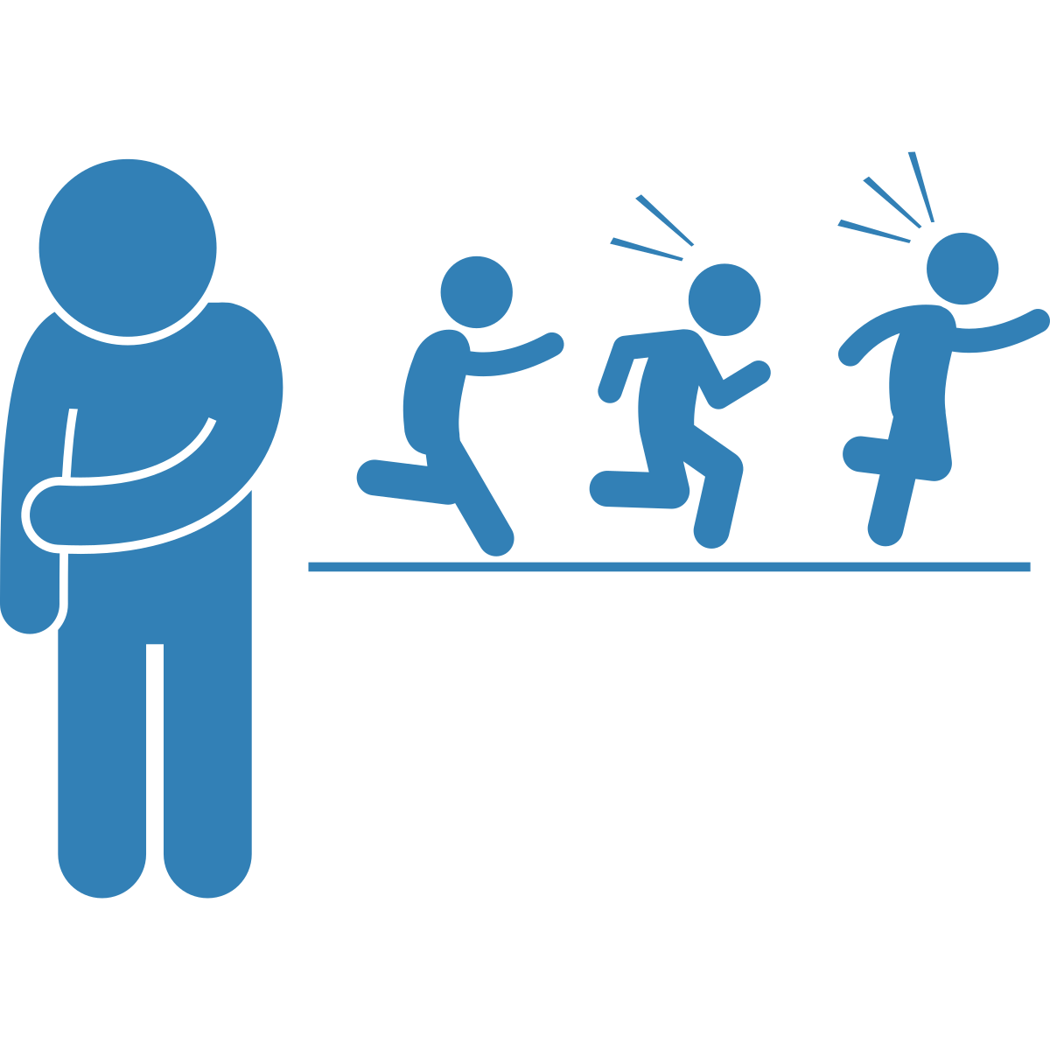
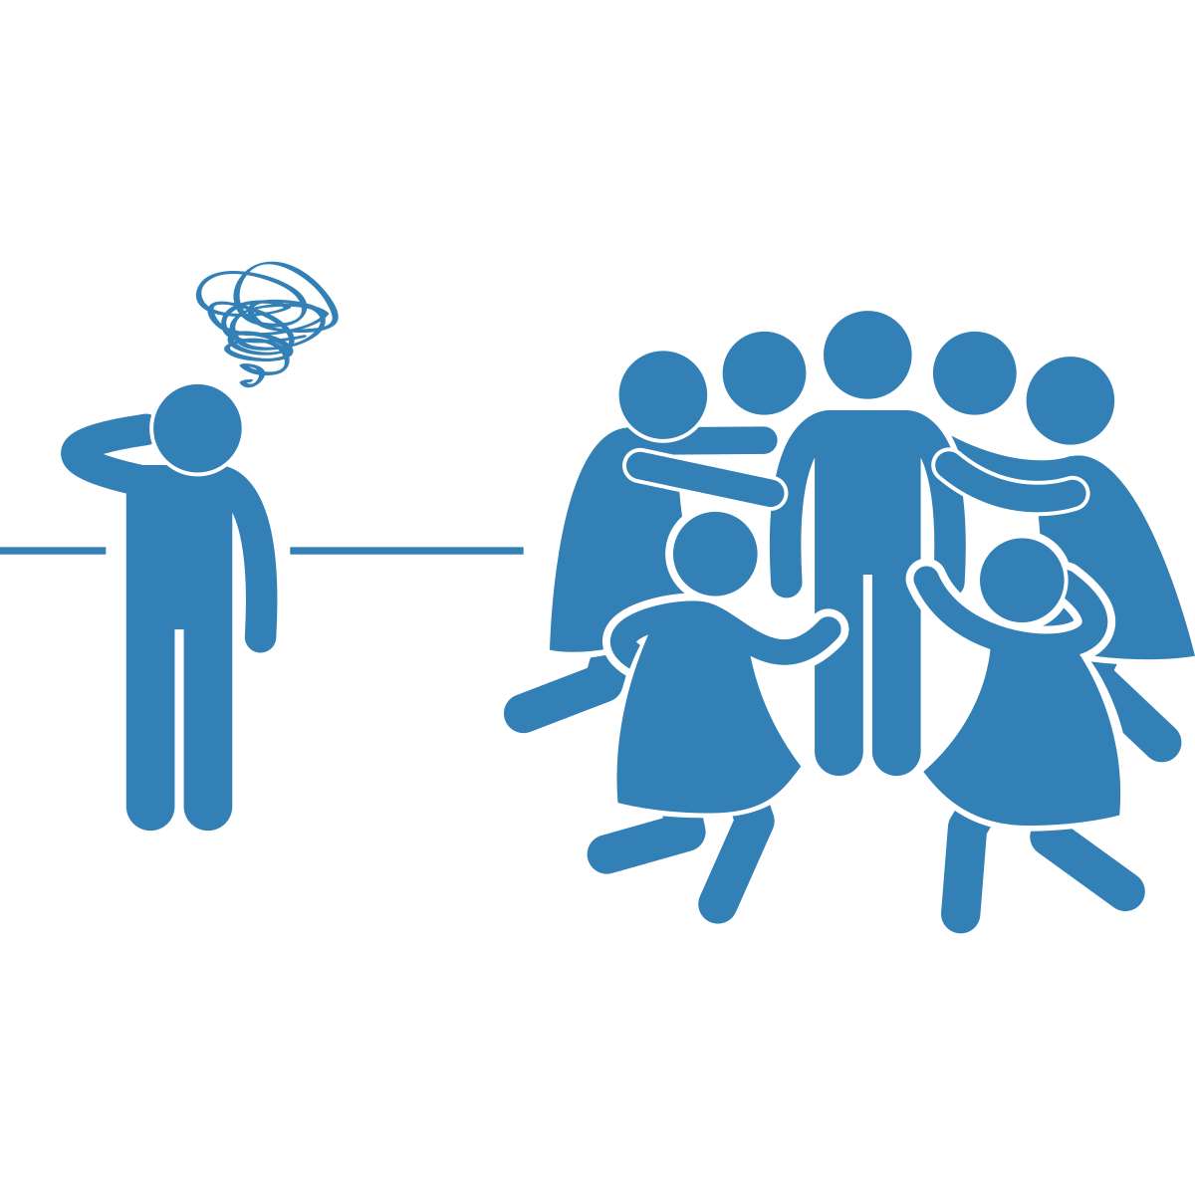
Notes:
and other groups who started off with less power and status can become excluded and more vulnerable to experiencing identity-based bullying.

Slide 14
Notes:
Often, the groups who gain power in schools reflect those who also hold more power in society. For example, in the school environment, youth who are racialized, disabled, or trans are much more likely to be excluded than White youth, able-bodied youth, and cisgender youth, respectively. Thus, we need to understand how the power differences we see within social groups at school are often [CLICK] reflective of larger power differences in society. In doing this, we can understand and challenge the root causes of identity-based bullying.

Slide 15
Notes:
For example, identity-based bullying based on race happens because children come to believe their own race is better than other people’s race, which stems from and is upheld by the power imbalances that exist between White groups (the dominant group) and Ethnocultural groups at the societal level. Because of these societal-level power imbalances and associated racist beliefs, Ethnocultural children and youth are more likely to become targets of identity-based (also called racial) bullying.

Slide 16
Notes:
You might observe this in your own classroom. Maybe you’ve noticed certain groups of students [CLICK] who always sit together, and certain students [CLICK] who are isolated from the others, based on their identity (e.g., all the White youth sitting together).
Many times, the students who are isolated from the others have aspects of their identities that are de-valued by society. Perhaps they are of darker skin colour, have a physical disability, have ADHD, or have larger bodies. This process of de-valuing people based on their characteristics is due to systemic discrimination, not because of anything to do with individual youth.
As educators, we need to be aware of how peer groups are being formed, who is being included, and who is being left out. Due to peer group dynamics, some students are more likely to become excluded and marginalized because of their identity as compared to others. Individuals who are marginalized and excluded have less social power and are often bullied by students who have high social power, because they belong to the majority group. If we don’t do anything about this, the power differences, and the bullying, will only continue to grow with time.

Slide 17
Social Architecture
Notes:
As an educator, you can use something called [CLICK] ‘social architecture’ to address this.
Social architecture is a method where adults intentionally organize the way youth work together in groups to make sure [CLICK] everyone is included. Social architecture not only promotes positive interactions between students, but to also create conditions that reduce the likelihood of bullying.
Think about how often you have students work together in groups or on teams. For many educators, this is a common practice. For example, having students work together on a class assignment, or having students be team captains and choose who they want on their team in gym class.

Slide 18
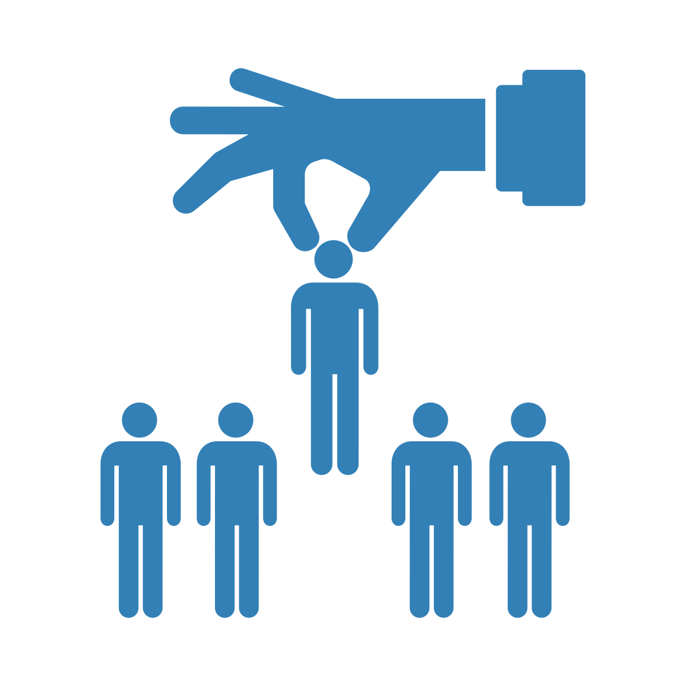
Notes:
Many educators know that when we let students choose groups, they pick people who are similar to them and/or who are popular. The students who don’t get picked or are picked last, are the ones who have been excluded time and time again, often because of their identities. This perpetuates the divide between students with higher social status and those with lower social status.

Slide 19
Notes:
To prevent this, educators can be intentional about creating groups for students, thinking about how to create groups that will result in positive and inclusive social and learning experiences for all students. Although this is a positive way to form groups, we need to be aware that when we create groups where students who are excluded and may experience identity-based bullying are given the opportunity to work together with kids who are supportive and prosocial, we need to monitor the group interactions to make sure bullying isn’t happening. By doing this, we can give these youth more opportunities to be safe and respected in a positive environment.
Facilitation guidance: It can be helpful for students to understand how they may be excluding others based on their identities. or activities that help students think about their identities, and how to identify points of similarities with other students they may not be aware of, see the “Development of Power” resource.

Slide 20
Notes:
The best setting for this ‘social architecture’ is where everyone in the group is working towards [CLICK] a common goal, and where each person’s diverse strengths and talents can be appreciated by all. Thus, it’s best to have students work together as opposed to having them work in groups to be competitive against one another (as that might reinforce power dynamics for winners versus losers).
Facilitation guidance: When you use social architecture for group projects, you may have to rethink how assignments are valued. Some students may really strive for a good grade, which can lead to bullying against kids who think others won’t work as hard as them (often based on racist, classist, or ableist assumptions).
Social architecture is not meant to force friendships. Instead, it’s meant to help make sure everyone has the opportunity to be accepted, included, and respected. It’s about giving everyone the opportunity to practice interacting with peers in a healthy, supportive environment. And, it’s about helping students see the many similarities they likely have with peers they perceive as very different based on surface characteristics.

Slide 21
Notes:
We can also create a healthy, supportive environment by openly talking about peer relationships and identity-based bullying. It can be hard for youth to confide in adults if they are experiencing identity-based bullying, as they may feel shame or embarrassment. But, if we can make it clear in our words and actions that we care, that we will listen non-judgementally to their concerns and respond with empathy, that we will thank them for having the courage to share their experiences with us, and that we will validate that everyone has the right to be safe and respected, they may be more likely to confide in us. You could even consider explicitly telling your students what action you will take if a student does come to you with concerns around identity-based bullying.

Slide 22
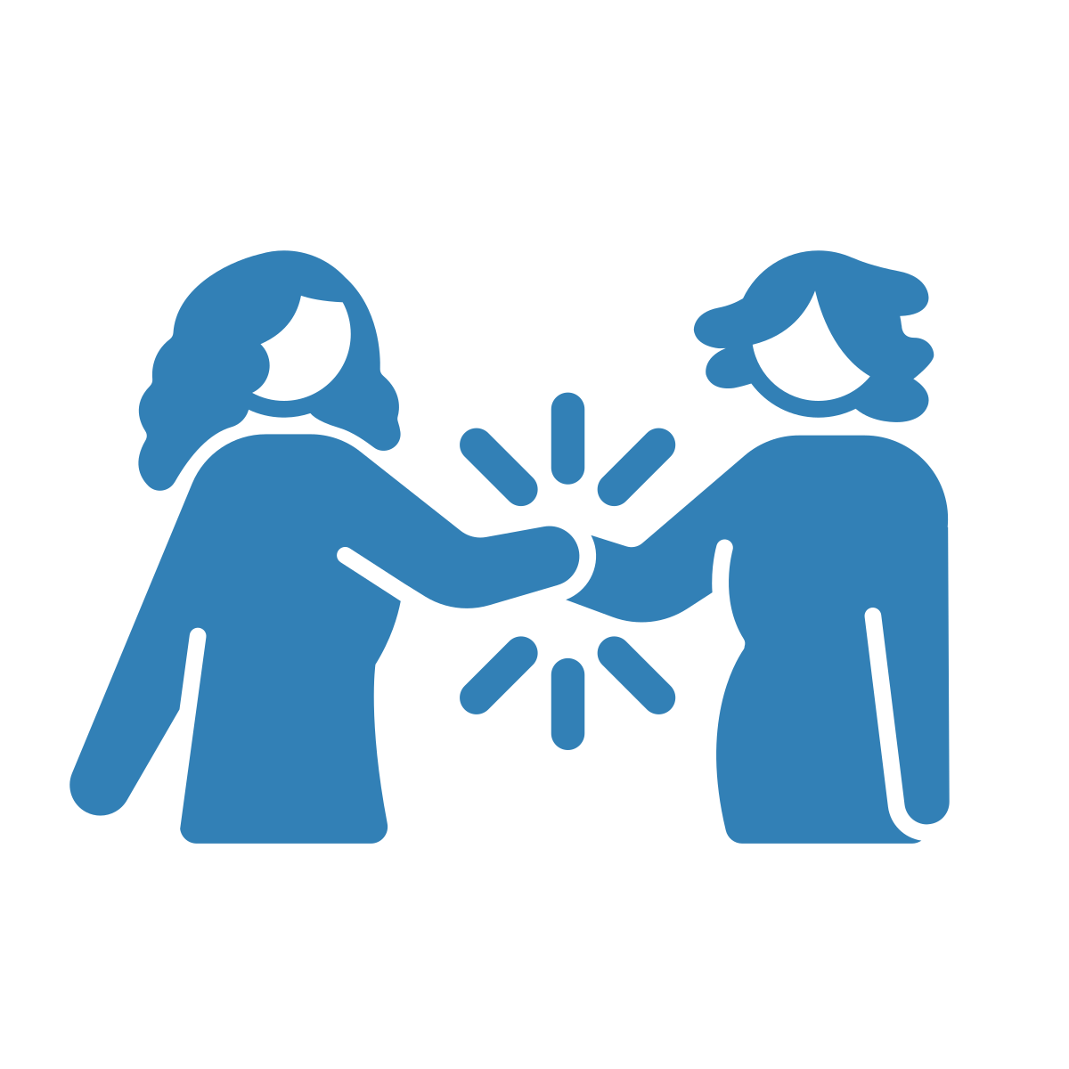
Notes:
As educators, we also set the tone for the relationships in our classroom. Students will look to educators for cues about how to behave. By practicing acceptance and using power positively by respecting and supporting others, we can model inclusivity. For example, we can use culturally responsive language. We can also make sure to not use stereotypes when we talk about different cultures. By showing students that we value and celebrate diversity, we model for students how to be inclusive.

Slide 23
Equity Literacy
Notes:
However, even though modeling behaviour where we accept and celebrate diversity, like using inclusive language and hanging pride flags, is very important, it isn’t enough on its own to prevent and disrupt identity-based bullying. Beyond celebrating diversity, we also need to help youth develop something known as [CLICK] ‘equity literacy’, a concept developed by Paul Gorski & Katy Swalwell. Equity literacy means we need to help students recognize identity-based bullying and respond when they see it happening. As youth go through adolescence, [CLICK] they develop the ability to question, critique, and reimagine the way society is set up. Thus, they are in a place where they can be meaningfully engaged in critical thinking and discussion about things like racism, ableism, and homophobia, all of which are root causes of identity-based bullying.

Slide 24
Notes:
There are many wonderful resources at the Equity Literacy Institute that can help you develop your student’s equity literacy. For example, [CLICK] you can ask students to bring in a newspaper or magazine article, which can start a conversation about biases. [CLICK] Having open dialogue on things like racism and homophobia is important, as it will help your students recognize, understand, and integrate concepts like power imbalances and justice into their everyday thinking. Building opportunities for these conversations into your everyday curriculum also supports youth to develop something called critical consciousness, or the ability to reflect on, analyze, and act to change oppressive systems, like those that lead to identity-based bullying.
Facilitation guidance: for resources from the Equity Literacy Institute, visit this website: https://www.equityliteracy.org/educational-equity-resources

Slide 25
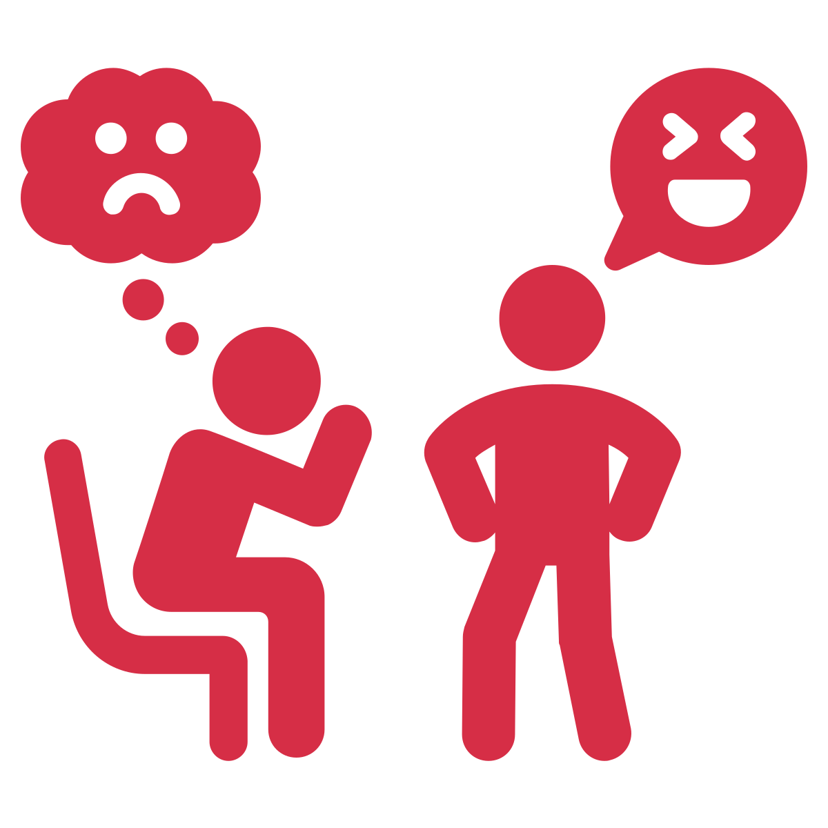
Notes:
So far, we’ve talked about how to create groups and settings that foster inclusivity. Another equally important thing to do is to make sure we notice and intervene when groups are forming that foster exclusivity.
If we see a group of students [CLICK] who constantly bully or make another student’s life (or group of students’ lives) miserable, then we need to intervene with those who are bullying. We should ask students who are bullying to do restorative work [CLICK] where they learn to understand why their behaviour was harmful, and how to engage with their peers in non-harmful ways.
Restorative work can take time and may be hindered if students are surrounded by peers who reinforce bullying. By letting the students who engage in bullying sit together and/or work together, we allow for bullying behaviours to be reinforced. Because of this, students should be separated from those who reinforce bullying behaviour until they have completed their restorative work.

Slide 26
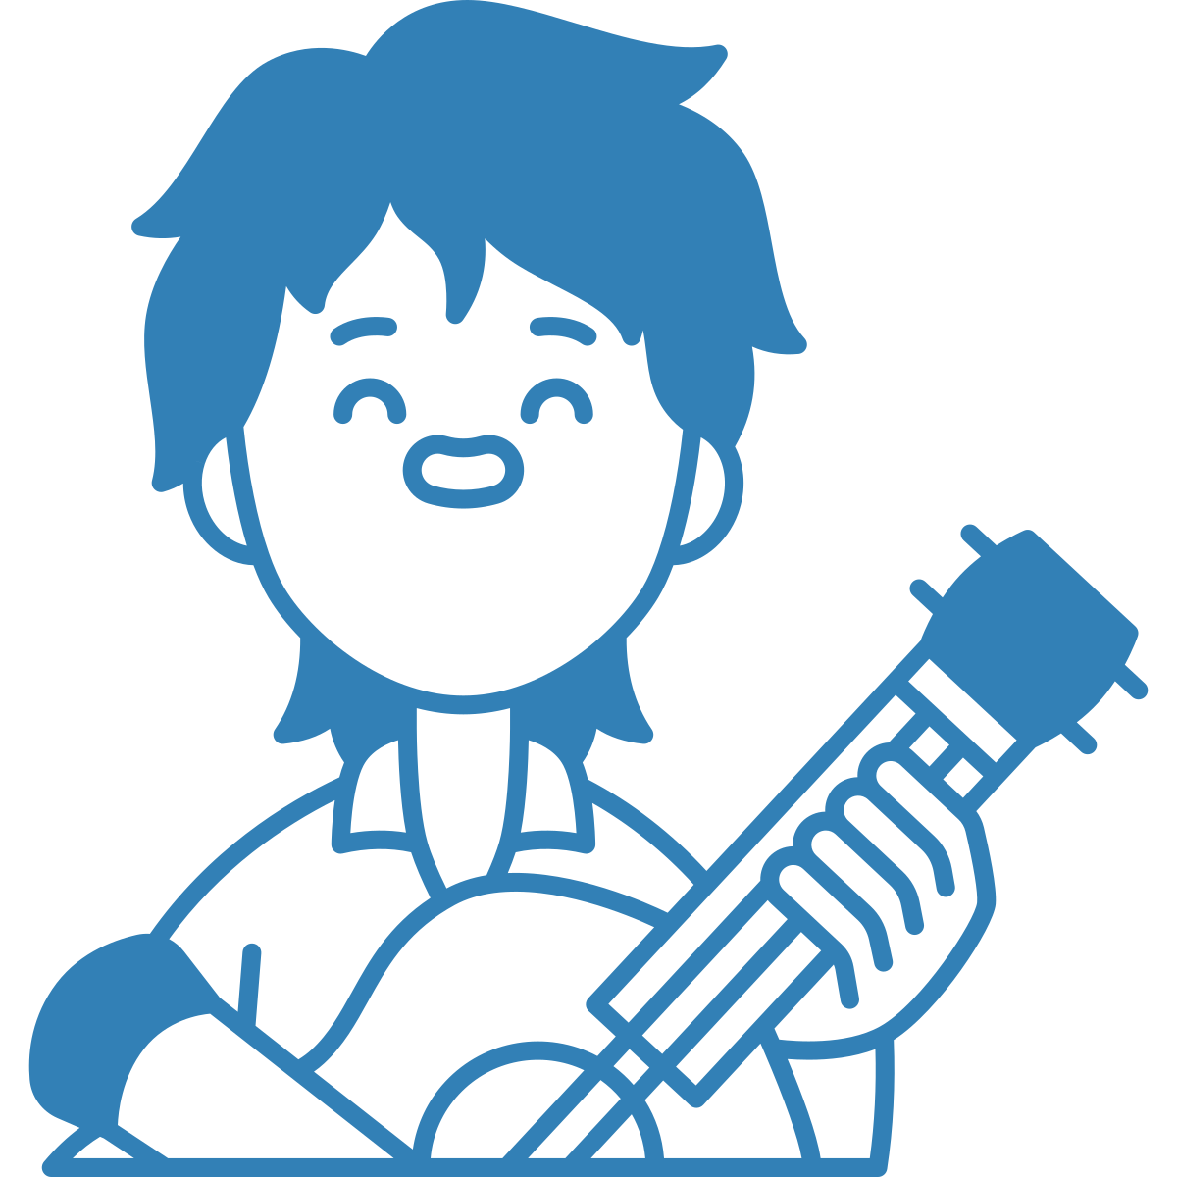
Notes:
Finally, let’s talk about a few things we can do at the school level to address power dynamics related to bullying, something many educators are already doing.
First, consider the ways you can help students who have been marginalized and excluded to feel included. For example, [CLICK] maybe you notice a student is talented at art, music, drama, sports, or technology. That student should be given opportunities to further develop those skills, and have them recognized and celebrated, increasing their social power. That student could also be given opportunities to meet with other youth who have similar interests. [CLICK] For example, by connecting them to a school club, exploring barriers to their engagement in the activity, and working with them to address those barriers so they can fully participate in the activity. When students know their educator cares about them and sees they are unique and talented, it can help them feel included.

Slide 27
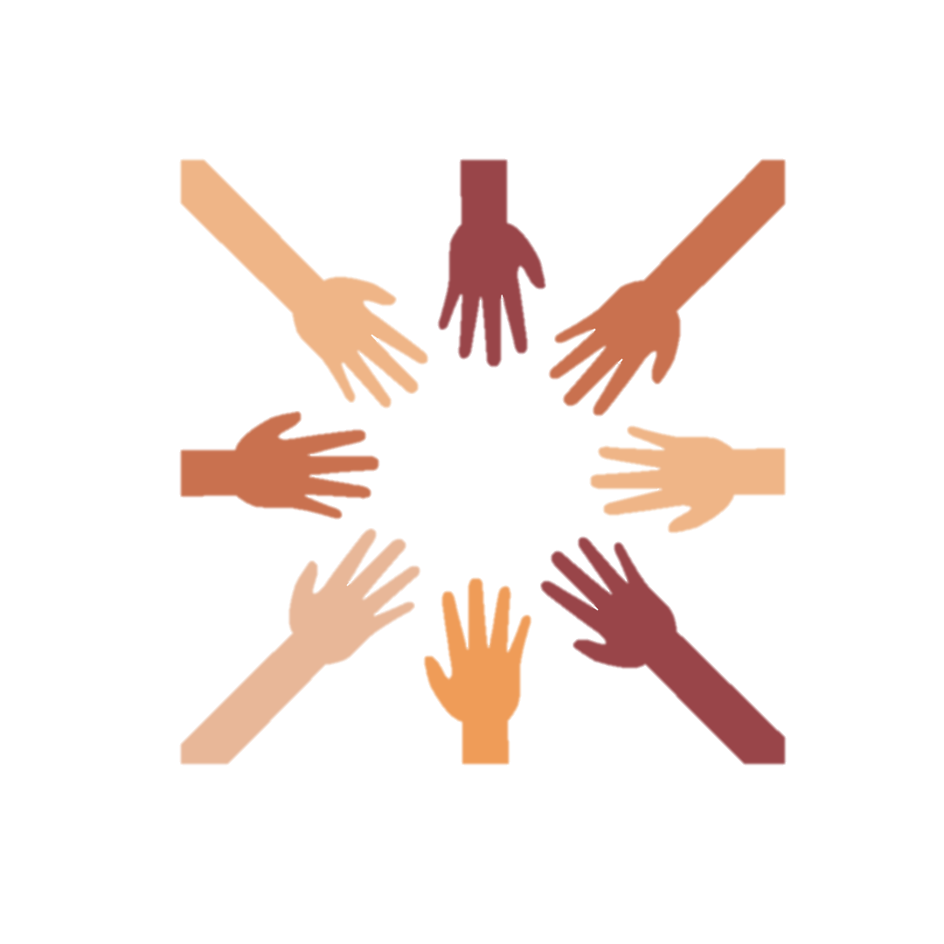
Notes:
Conversely, it’s important to notice if there are certain groups of students who are always given leadership opportunities, [CLICK] and think about ways to diversify leadership roles in your school.

Slide 28
Protected Spaces
Notes:
It’s also critical to ensure there are protected spaces where students we know are often marginalized based on larger societal beliefs can go to receive support and validation. This includes gay-straight alliances, Indigenous spaces, and other clubs that reflect the racial and ethnic make-up of your school. Asking youth what types of resources and activities they are looking for can help as well, as we do not want to make assumptions about their needs.
For example, perhaps there is a dance club that exists, [CLICK] but it is focused on White, western dance styles. Would Ethnocultural youth feel valued in that space as well? Speaking to them can help ensure their needs are heard, and you can work with them to include [CLICK] additional dance styles for example.

Slide 29
Review Curriculum
Notes:
Furthermore, you can identify ways to change your curriculum to reflect all learners in your classroom.
You can start by asking yourself: does the curriculum look like the students in the classroom?
If not, what are ways you can work with the students in your classroom to change it?
For example, maybe you notice [CLICK] that all the authors for required readings are White men. You could work with students to find books from diverse authors [CLICK].
You can also ensure you’re using diverse examples during lectures, ones that reflect the students in your classroom.

Slide 30
Notes:
At the school level, there should also be policy that specifically addresses identity-based bullying. This policy should include clear steps for how educators can connect with those who have used identity-based bullying, to help them understand why they may have done it, why it was harmful, and other strategies they can use in the future to interact with their peers in healthier ways. This restorative approach is key to helping youth who use identity-based bullying to build the knowledge and skills they need to prevent it from happening again.
Facilitation guidance: For more information on restorative practices, see here: https://www.prevnet.ca/resources/healthy-relationships-tool/relationships-first-restorative-justice-in-education

Slide 31
Notes:
Of course, we also want to follow up with the students who experience identity-based bullying. Supporting these students includes listening to them, validating their experience, acknowledging that what was said was wrong and not their fault, letting them know that behaviour isn’t tolerated and what you have done to address it, and directing them to a professional should they want more support.
If policies like this don’t already exist, consider talking to your administration to create these policies and processes.
Facilitation guidance: For more information, see here https://www.prevnet.ca/resources/bullying-prevention-facts-and-tools-for-schools

Slide 32
1
Harm of students choosing own groups.
2
Using social architecture.
3
Creating healthy environments.
4
Being a positive role model.
Summary
5
Developing students’ equity literacy.
6
Creating school-level change (policy).
Notes:
To summarize, we’ve talked about:
[CLICK] Why letting students choose their own groups can be harmful
[CLICK] How to use social architecture to create opportunities for all students to be safer and respected in a positive environment
[CLICK] Creating a healthy environment in our classrooms by talking openly about peer relationships and identity-based bullying
[CLICK] Being a positive role model in the classroom, practicing acceptance and using power positively
[CLICK] Helping students develop equity literacy, and
[CLICK] Creating change at the school level (for example, by creating policies to address identity-based bullying)

Slide 33
Strategies to Make a Difference
1
Creating diverse groups.
2
Intervening.
3
Being a positive role model.
Notes:
As an educator, you yourself are in a position of power. This gives you the ability to change students’ lives for the better. We’ve talked about various strategies you can use, including
[CLICK] Creating diverse groups
[CLICK] Intervening when you notice inappropriate behaviour
[CLICKAnd being a positive role model
By making small changes, like using culturally responsive language, having clear anti-oppressive policies (which refer to policies that actively and continually challenge systems of oppression), and helping youth develop equity literacy, you can be a positive role model and make a big difference.

Slide 34
Questions for Educators
Do you notice some students who sit together all the time, and some who are excluded?
How could you create groups (and/or seating arrangements, teams, pairings) to promote inclusivity and make sure all students have the opportunity to be included in a supportive way?
What strategies can you use to ensure every student is included, accepted, respected, and safe in a peer group?
Are there ways to identify similarities across all students to foster cohesiveness in your classroom?

Slide 35
Questions for Educators
Are there opportunities to talk about diversity and power with your students, and celebrate it?
What language can you use regularly in the classroom to model inclusivity?
What language should you be avoiding using (e.g., stereotypes)?

Slide 36
Questions for Educators
Can you work with students to identify ways to make the physical environment more inclusive (e.g., posters on walls)?
Can you work with students to identify ways to diversify your curriculum (e.g., using diverse examples; reading from diverse authors; key lessons that can be used to have these conversations)?

Slide 37
Discussion for Students
How can we make the physical environment of our classroom more inclusive for everyone?

Slide 38
Discussion for Students
How can we change our curriculum so everyone feels seen?
Notes:
Facilitation guidance:
You can start by asking yourself: does the curriculum look like the students in the classroom?
If not, what are ways you can work with the students in your classroom to change it? For example, maybe you notice that all the authors for required readings are White men. You could work with students to find books from diverse authors.
You can also ensure you’re using diverse examples during lectures, ones that reflect the students in your classroom.
Brainstorm ways to improve the curriculum, ensuring the changes are youth-led.

Slide 39
Thank you to partners and collaborators!
Financial contribution from Ontario Ministry of Education

