Slide 1
Development of Power
Teaching and Learning Resources
to Prevent Identity-based Bullying
LESSON TWO:

Slide 2
Land Acknowledgement

Slide 3
What is Bullying?
Destructive relationship
Power imbalance
Repeatedly aggressive with intent to harm
Notes:
At least 1 in 3 youth in Canada will experience bullying at some point in their lives.
Bullying is a [CLICK] destructive relationship where one person or a group of people [CLICK] holds power over another and [CLICK] intentionally acts aggressively to harm them. This is often done repeatedly. Bullying can happen in person or online.

Slide 4
Notes:
Everyone has the right to be [CLICK] respected, to be safe, and to be free from mistreatment of any kind, including bullying. When children and youth experience bullying, their rights are violated, making bullying both wrong and unjust.

Slide 5
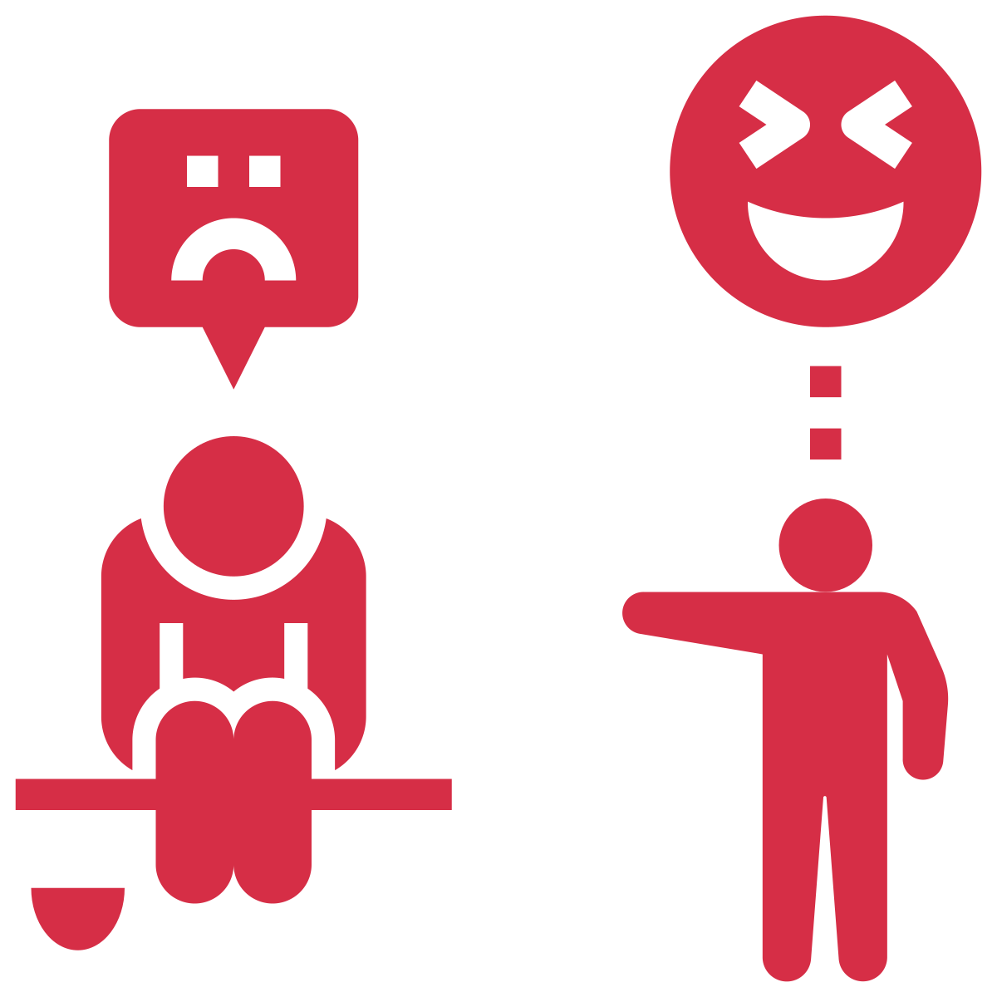
Notes:
Although many children will explore how to use power to bully others when they are young…

Slide 6
Notes:
The majority of these children will learn that bullying is a hurtful way to behave in relationships and will instead [CLICK] learn healthy ways of interacting with their peers.
As children grow and develop, they have many opportunities to learn how to form trusting and respectful relationships with others. For example, over time many youth develop social emotional skills that allow them to empathize with others, learn how to take turns in conversations, and how to resolve conflict in healthy ways.
In fact, once youth reach the age of 12 or 13, most have learned healthy relationship skills and are not persistently bullying others.

Slide 7
CHILDREN’S DEVELOPMENT
Notes:
However, there are a small minority of children who will continue to use power and aggression in unhealthy ways throughout childhood, adolescence, and into adulthood.
There are many different paths that can lead to bullying behaviour.
Today, [CLICK] we’ll talk about key points during children’s development where they have opportunities to learn about the use of power in relationships. Depending on what the children learn about power at each of these key points, they will either be more likely to use aggression, or less likely to use aggression.
If children continually learn to use power in a negative way as they grow and develop, they will be more likely to use aggression throughout their lives. However, if children can learn to use power in a positive way as they grow and develop, then they will be less likely to use aggression, and instead will learn healthier ways of interacting with others.

Slide 8
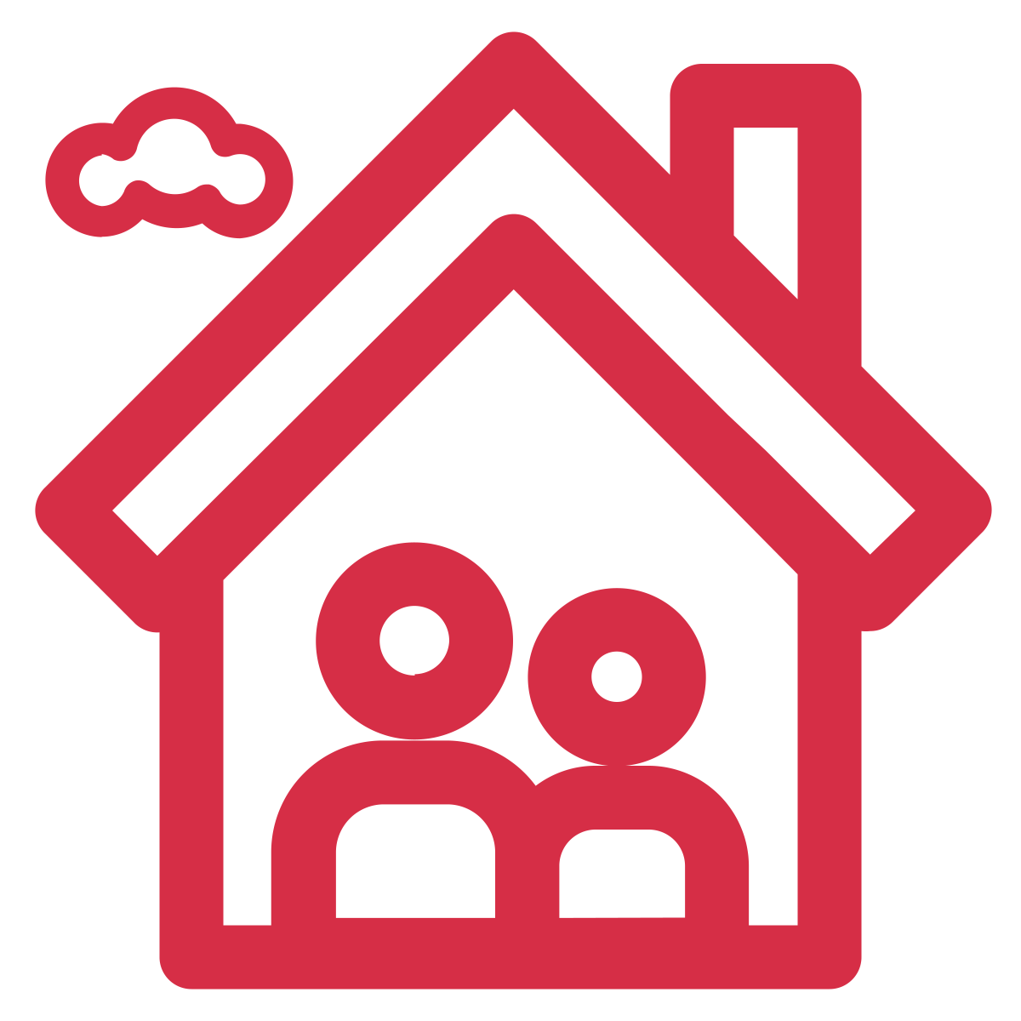
Learning About Power
Notes:
Children first learn about the use of power in relationships from adults in their home environments.
[CLICK] Adults naturally have power over children in their relationships, as they are older and have easier access to things like food, clothing, and shelter.

Slide 9
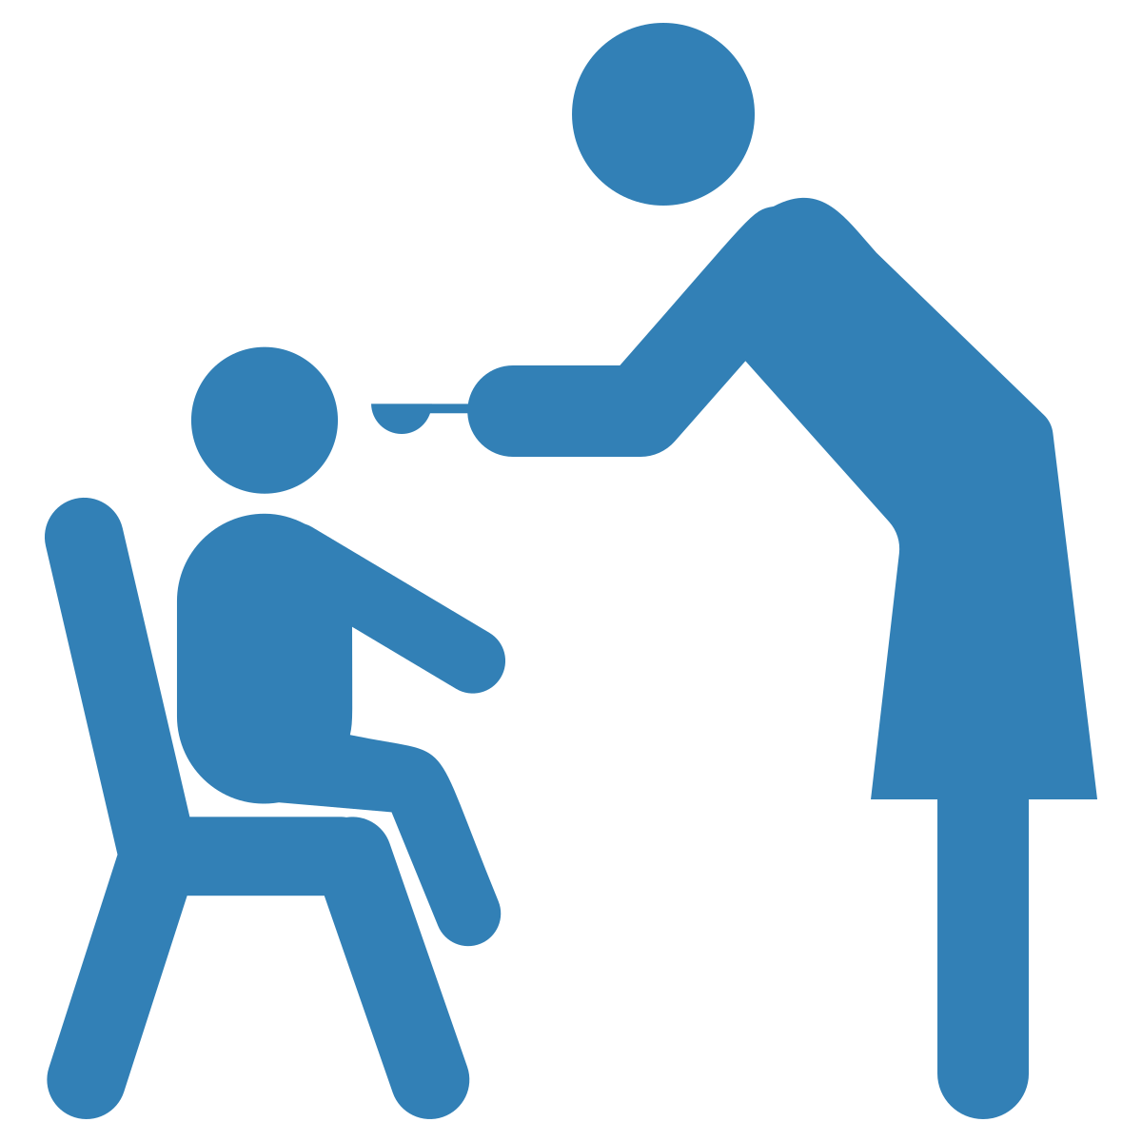
Learning About Power
Notes:
Adults have the opportunity to use power positively to promote children’s healthy development. For example, [CLICK] adults can be a source of security for children, providing them with food, clothing, and comfort. By acting in the best interest of the children in their lives, adults can make sure that children feel respected and valued. By doing this, children learn they can turn to adults who can help them.
Adults can also teach children positive ways of addressing anger and conflict. For example, [CLICK] adults can treat others with respect, resolving conflict by actively listening to concerns and taking responsibility when they have made a mistake. If adults can lead by example, they can help the children in their lives learn how to use power positively.

Slide 10
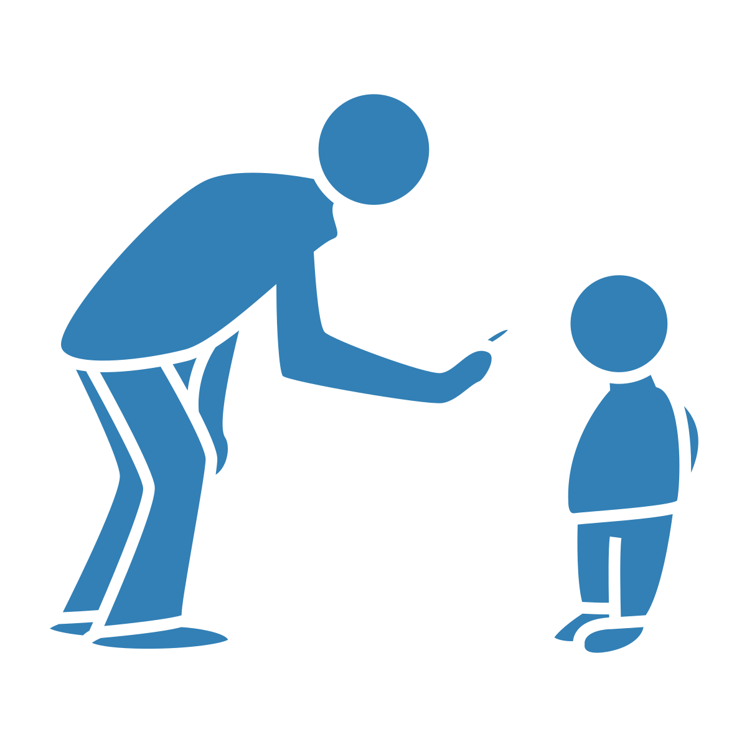
Learning About Power
Notes:
However, adults can also use power in a negative way. For example, [CLICK] adults could threaten to not feed their children dinner if they don’t clean their room. Threatening to not feed children dinner is a negative use of power, as it violates children’s right to food.
When adults use power to silence, scold, or put down children, they teach them that power can be used in negative ways to get what they want.
Children can also learn about using power in negative ways by observing how adults in the home interact with each other.
If one or both of the child’s caregivers are using power aggressively, children will again learn that aggression can be a powerful tool to gain control over others.
For example, [CLICK] children might observe a caregiver physically hurting the other caregiver in response to conflict. If this happens, the child may learn that the best way to resolve conflict is by using aggressive power.

Slide 11
Learning About Power
Notes:
Children also observe how adults treat other adults outside the home, for example [CLICK] in youth-serving organizations, [CLICK] at places of worship, [CLICK] when out shopping or at a restaurant, and at school. By observing how these relationships work, they continue to learn about what is acceptable behaviour in relationships. If the relationships they see use power aggressively to gain control or to reach a desired outcome, children will learn that this is acceptable behaviour to get what they want.

Slide 12
Notes:
By the time children enter school, some may have learned that using power and control in relationships is an effective strategy to get people to do what they want. Unfortunately, they may try to use power and aggression in the school setting with their peers [CLICK] in the form of bullying.
School entry is another key point where children have the opportunity to learn about the use of power in relationships.
If these children bully their peers and no one intervenes, it will reinforce the idea that power can be used effectively to get what they want in relationships. They may not understand that the use of power is hurtful, and/or they may not know other ways of interacting with their peers.

Slide 13
Notes:
At this point, educators can help teach lessons to change their students’ understanding of power. For example, [CLICK] educators could intervene when they observe bullying, helping students to understand that it is both wrong and hurtful to use power in a negative way. If educators do not intervene in bullying, including identity-based bullying, when it happens, then they are inadvertently reinforcing their students negative use of power.
By intervening, educators can help students learn better ways of interacting with peers, [CLICK] focusing on conflict resolution skills, for example.

Slide 14
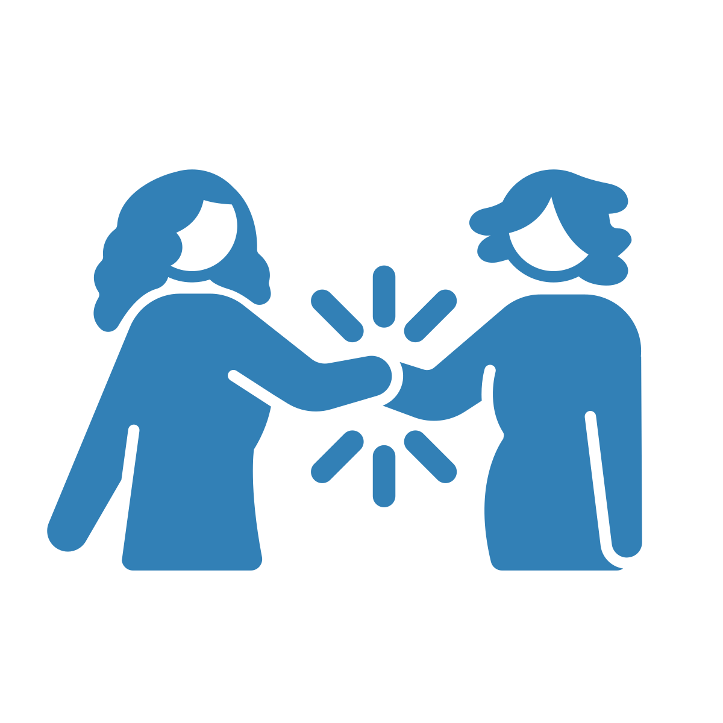
Notes:
Educators can also act as role models, using power positively to show their students healthy ways of interacting with others. Much like adults in the home, educators can be responsive to their students’ needs and treat them with respect, teaching them that they can turn to adults for help when needed. Educators can also treat other adults with respect, modeling healthy behaviour in the classroom. For example, by being kind to other educators and school staff.

Slide 15
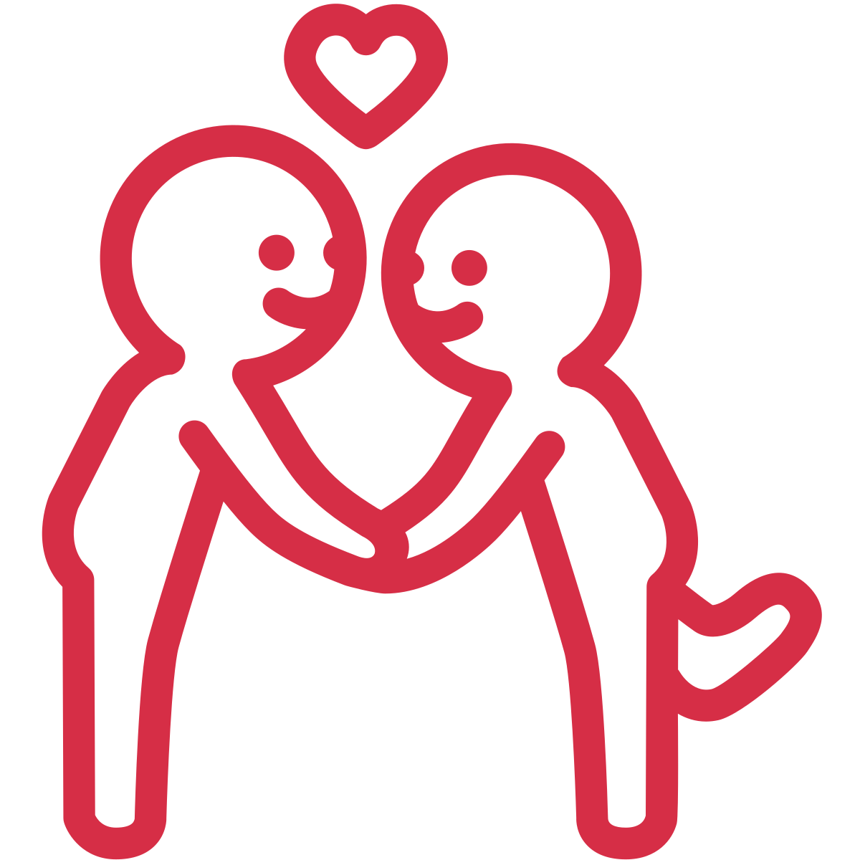
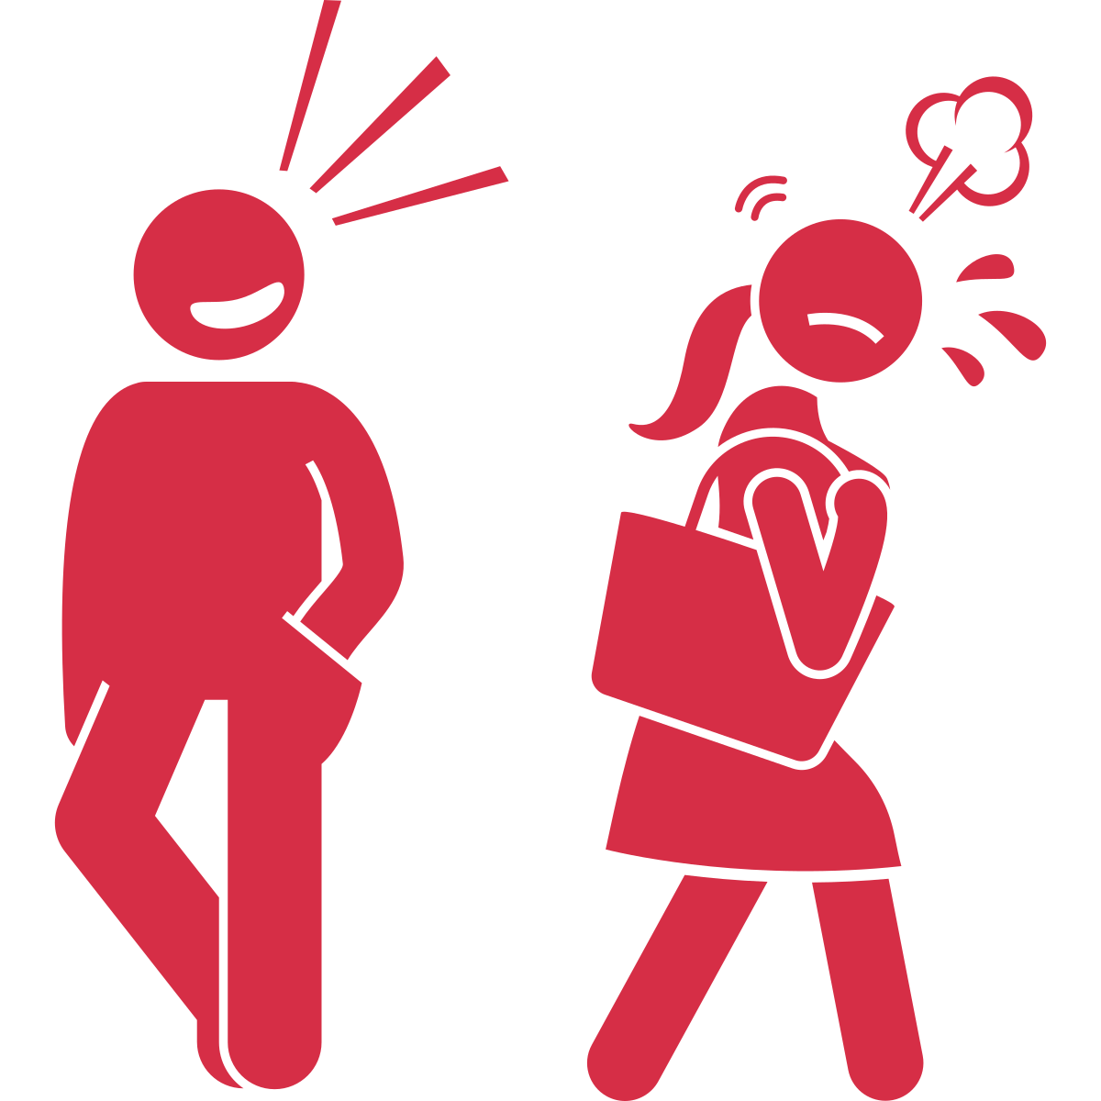
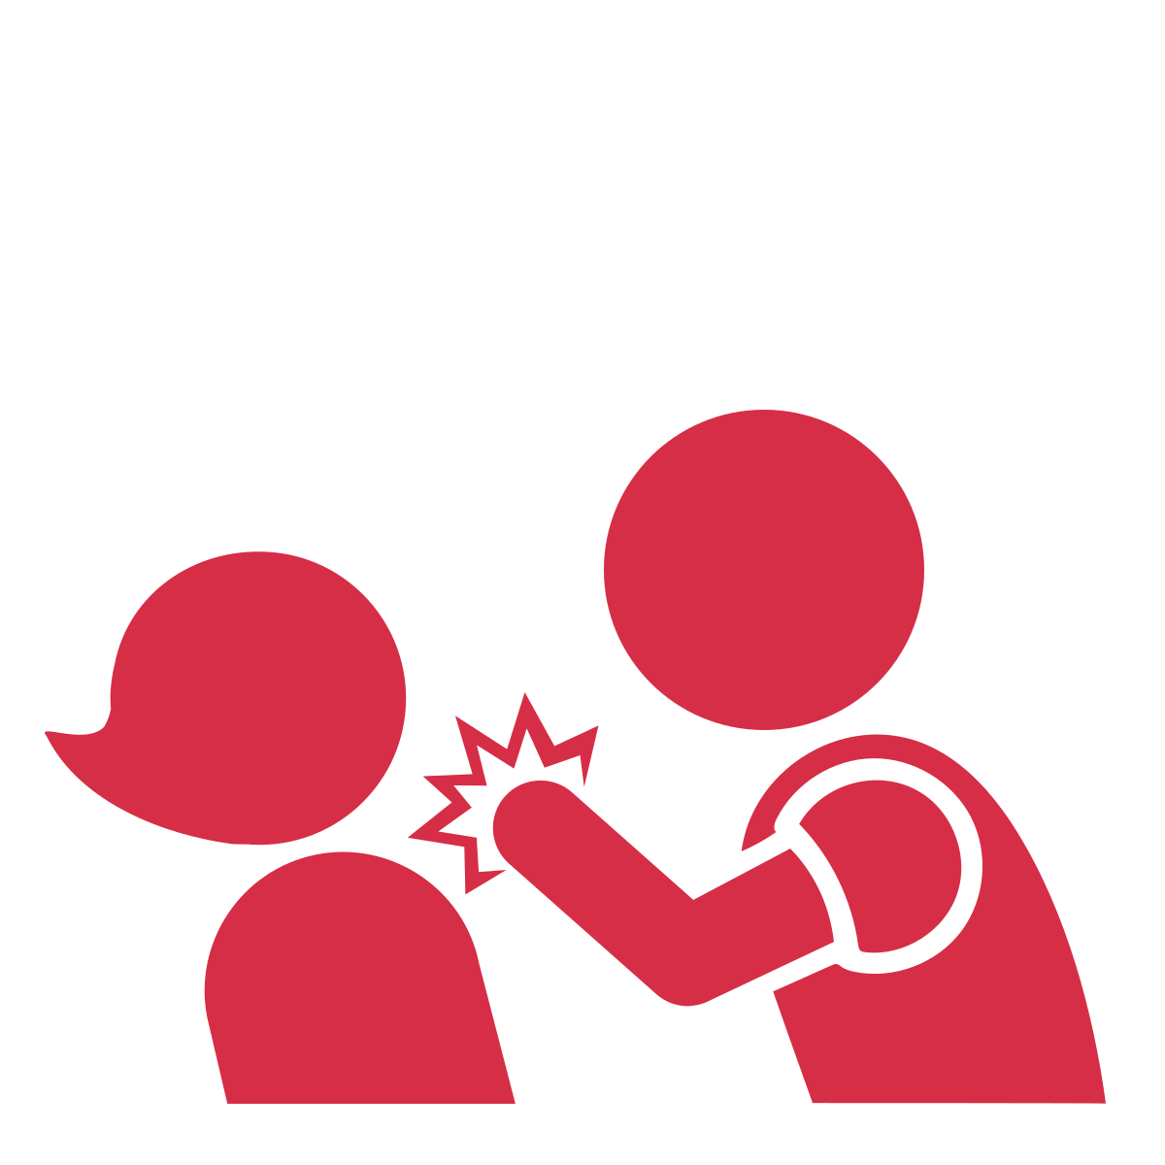
Sexual harassment
Dating violence
Notes:
With increasing age, children and youth begin to explore their sexualities in more depth, and many (though not all) will begin navigating romantic and sexual relationships with others. If they have learned to use power aggressively in previous relationships, like with adults in the home environment and in other settings, or with their school-age peers, they are then more likely to use power aggressively both in their adolescent peer groups and with their dating/sexual partners.
This negative use of power can show up as [CLICK] sexual harassment, which includes things like unwelcome comments, touching, or intimidation.
It can also show up as [CLICK] dating violence, which involves aggressive, threatening, or manipulative behaviour in teen romantic or sexual relationships.

Slide 16
Using Power Across Relationships
Notes:
This means that for some children and youth, there is continuity across relationships, where children learn how to use power aggressively from adults in their home, community, and/or school settings, with their peers, and then also in sexual and romantic relationships.

Slide 17
Identity-based Bullying
Notes:
There are also key transitional times along this development of power path where the use of something called identity-based bullying may become particularly relevant. Identity-based bullying targets people based on their identities. For example, calling someone hurtful names because they are gay, excluding someone because they are of a different race, or whistling at someone because they’re a girl.
The differences in power that are at the root of identity-based bullying have been created by society, by oppressing some groups and privileging others over time. Because of this, some groups in society continue to have more power as compared to others (for example, heterosexual youth hold more social power than queer and trans youth, because society gives more social power to heterosexual people).

Slide 18
Identity Formation
Notes:
The first transitional time is when children start forming their sense of who they are in the world, and learn about differences between themselves and others.
One theory that helps us understand how humans tend to behave when in groups is “intergroup conflict theory”.
This theory tells us that from a very young age (as early as 3), [CLICK] children tend to classify themselves [CLICK] according to groups. They classify themselves according to things like gender, physical appearance (like skin colour), interests, values, spoken language, and culture.
Once children make these classifications, they tend to form groups with peers who are similar to them. So, they may become friends with others who have the same skin colour, or gender, or are similarly aggressive, for example. Over time, through interacting with their peers, they actually become more similar to their peers in terms of attitudes, beliefs, and behaviors.

Slide 19
Notes:
Per intergroup conflict theory, once these groups are formed, children behave in ways that favour their own group over other groups. As a result, they make comparisons between themselves and others who are different than them, where their own group comes out on top. And, by age 4, children start to show a preference for the groups they belong to as compared to other groups.
Over time, [CLICK] this leads to children forming an “us vs. them” mentality where they favour their own groups and discriminate against groups that are different from them.
This process sets the stage for identity-based bullying, as people tend to bully those outside of their own groups – people who are different from the group they belong to.
Even though you are not teaching this age group, it is still important to understand that one way to prevent identity-based bullying is to intervene when children are young. In other words, there are things we can do even before identity-based bullying happens with teens.

Slide 20
Notes:
As a result, the groups who already had status and power tend to [CLICK] gain more status and power…

Slide 21
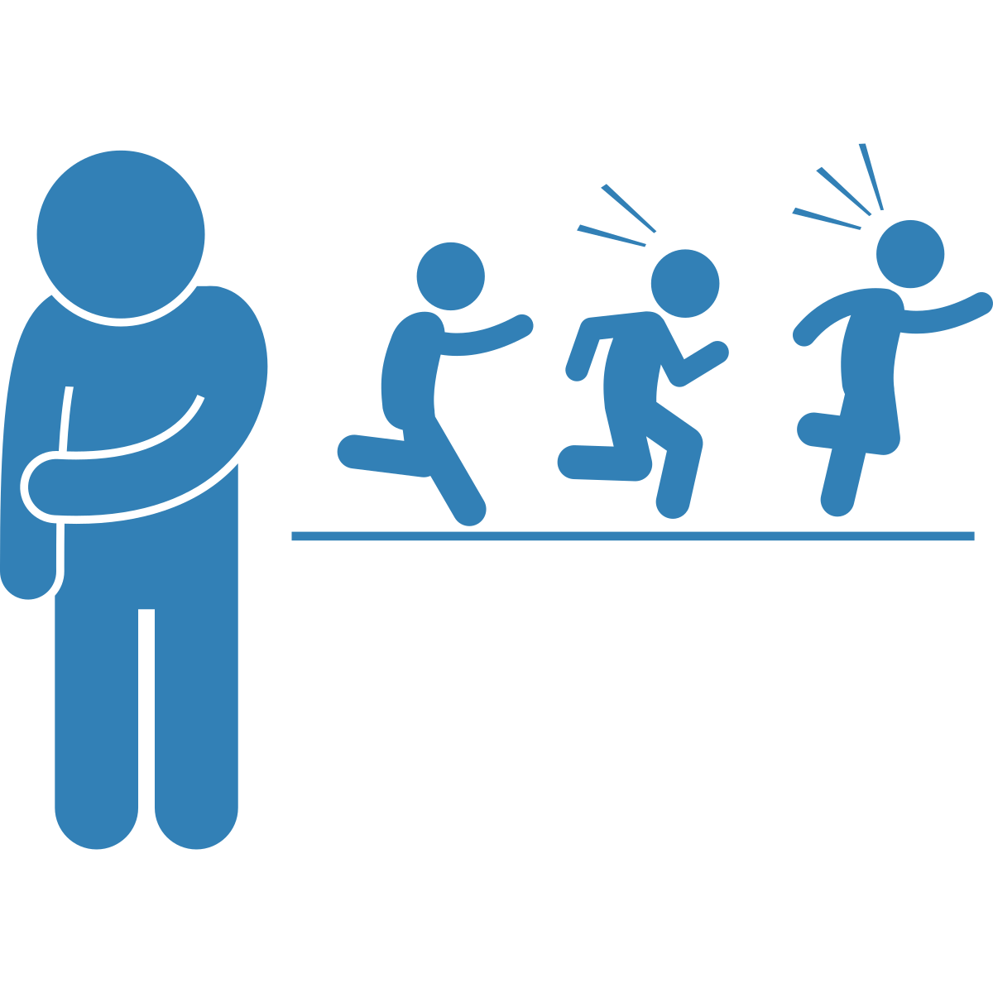
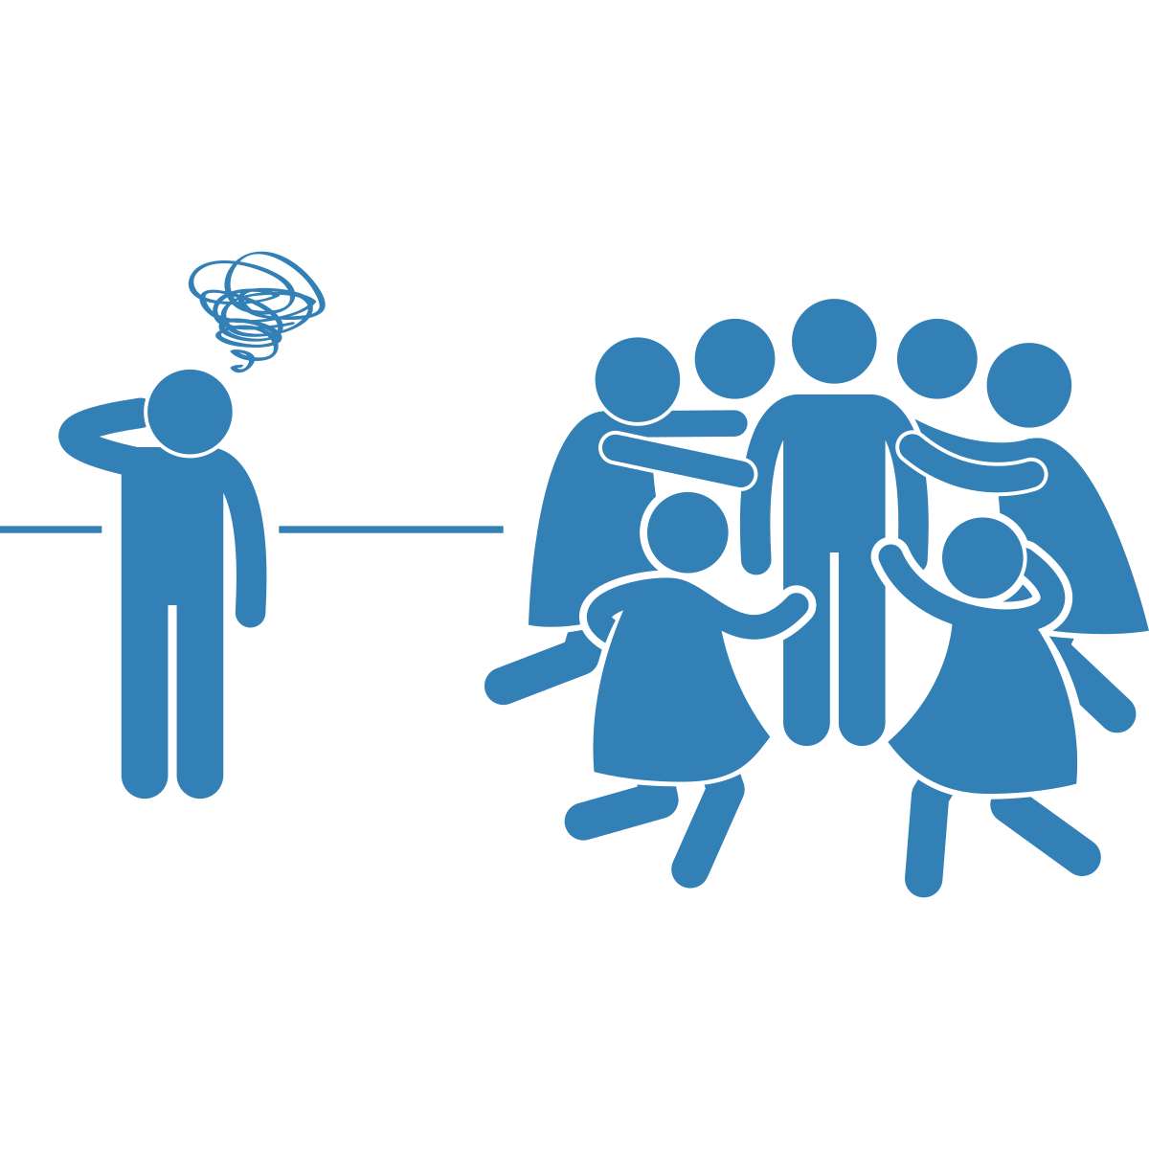
Notes:
…and other groups who started off with less power and status [CLICK] can become excluded and more vulnerable to experiencing identity-based bullying.

Slide 22
Notes:
Often, the groups who gain power in schools reflect those who also hold more power in society. For example, in the school environment, youth who are racialized, disabled, or trans are much more likely to be excluded than White youth, able-bodied youth, and cisgender youth, respectively. Thus, we need to understand how the power differences we see within social groups at school are often reflective of larger power differences in society. In doing this, we can understand and challenge the root causes of identity-based bullying.

Slide 23
Exploring Gender and Sexual Identities
Peer
Groups
Identity-based Bullying
Notes:
Another key time when identity-based bullying might increase is when youth go through puberty. During this time [CLICK], many youth intensify their exploration of their gender and sexual identities, in addition to all the other identities they hold.
Focusing on sexuality as an example, that means they begin to really explore if they are attracted to boys, girls, both, all, or none.
Youth might explore these questions in private, but the process is also affected by [CLICK] their peer group.
For example, peers set the norms (or rules) for whether it’s ok for people to be attracted to boys, girls, both, all, or none. If the peer group holds unhealthy attitudes about sexual identity – attitudes they have learned from larger social beliefs about what kinds of gender and sexual expression are accepted – they may have rigid and hurtful beliefs about what kind of behaviour is acceptable for their peers.
For example, if a girl comes out as a lesbian and the peer group holds homophobic attitudes, [CLICK] they may send hurtful messages online calling her derogatory names.

Slide 24
Notes:
Another key transitional period that might be related to increased identity-based bullying is when youth start exploring actual sexual and romantic relationships with other people. During this time, [CLICK] many youth feel unsure about who they are, and often feel uncomfortable in their own bodies and in the ways they interact with potential sexual and romantic partners. As youth attempt to develop skills to help them navigate this stage, they may resort to tactics that allow them to regain a sense of control and status. If they have learned to use power in unhealthy ways in their other interpersonal relationships, they may find this sense of control and status via identity-based bullying.

Slide 25
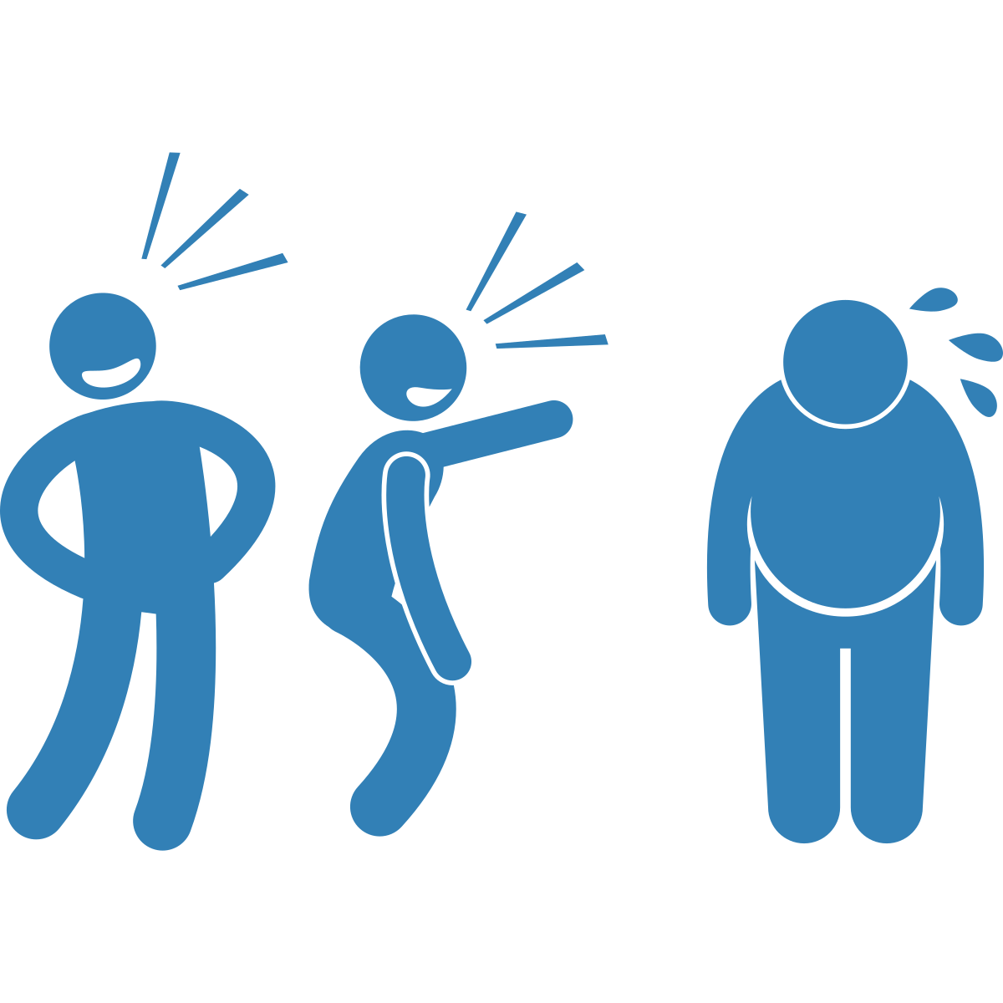
Notes:
For example, a youth may feel uncomfortable about their body. To regain control of the situation, [CLICK] they may use identity-based bullying to make fun of someone else’s larger body, something that has consistently been devalued in society. In this way, they have made a body shaming comment to make themselves feel better about their own body that is smaller.
Being aware of the times when identity-based bullying may increase can help us understand the unique reasons why people may be using power and control at that age.
However, identity-based bullying can happen at any time in development, so we should always pay attention to it, regardless of the students’ age.

Slide 26
1
Some youth learn to use power negatively.
2
Youth learn lessons about power at home, school, and other settings.
3
Lessons transfer to peers and dating/sexual partners.
Summary
4
Youth are more likely to engage in identity-based bullying at key transitional times.
Notes:
To summarize, [CLICK] there are a small number of youth who learn to use power in negative ways throughout their lives. [CLICK] These youth may have learned to use power negatively at home, at school, or other settings, and then [CLICK] transferred these lessons to their relationships with peers, and with dating/sexual partners.
[CLICK] Youth along this path are also more likely to engage in identity-based bullying, especially at certain transitional times. Specifically, when they are learning about differences between themselves and others, when they are exploring their sexual and gender identity, and when they are exploring sexual and romantic relationships.

Slide 27
Where and why do differences in power exist?
How is that power used?
What do we need to think about?
How do we share power with everyone in healthy ways?
Notes:
To help prevent the negative use of power, we can have discussions with our students about:
[CLICK] Where and why differences in power exist,
[CLICK] How that power is used, and,
[CLICK] How to share power with everyone in healthy ways.
Although we can’t change what everyone has learned before coming into our classroom, we can understand the lessons everyone in Canada learns as a result of the beliefs and norms of the dominant culture, and how those lessons influence school climate, classroom dynamics, and the relationships that form between and among people in the school. We can create classrooms where the use of power is modelled in a positive way, and we can create a school climate where all students are accepted and celebrated. But doing this requires understanding and working to address unhealthy uses of power that occur as a result of larger social beliefs.
This video has focused on understanding the various lessons about power that youth learn over their lifetimes, and how we can have conversations to help them understand ways to use power positively instead of negatively. To do this, let’s think about who is given power in our classrooms and in our schools, and the different ways we can help make sure the youth who don’t always get power are fully included and accepted for who they are.
FACILITATION GUIDANCE: In the next video (Peer Structures), we will build on this by talking about how to become aware of the different groups that are forming in our classroom, and how we can regularly change the seating arrangements or create group activities that mix the various groups that have formed in the classroom. By doing this we are providing opportunities for everyone to have the chance to interact and get to know all their peers while actively reducing ingroup favouritism.

Slide 28
Discussion
Question #1:
In our school, who (among students) has power?
Notes:
[ASK]
In our school, who (among students) has power?
[FACILITATION GUIDANCE]
Have the students lead the discussion. If they need help, below are a few ideas:
Popular kids
Athletic kids (able-bodied)
Attractive kids
‘Smart’ kids (neurotypical)
English speaking kids
Kids with affluent or wealthy parents
Kids of certain races and ethnicities
Remind students they should talk in general and not about specific students. Students should never use names of people in the school.
In addition, educators need to be aware of classroom dynamics. If some students in your classroom may be experiencing identity-based bullying, we want to ensure that they are not further harmed by this discussion. If asking who has power in the school seems like it may not be safe for all students in the class, or if you think students will struggle to keep the conversation general (and not specific), consider alternative activities.
For example, consider showing a video from one of the websites in the “Intro to Series” document, and discussion who holds power in larger society, and what that may mean for your school.

Slide 29
Discussion
Question #2:
How is that power used?
Notes:
[ASK]
How is that power used?
[FACILITATION GUIDANCE]
Have the students lead the discussion. Ask them to think about how power might be used both negatively and positively.
Negatively: joining in the bullying, cheering on the youth who is bullying, passively watching the bullying happen; making comments to support the person doing the bullying, ignoring it, name-calling, excluding, ignoring, threatening, etc.
Positively: intervening in bullying directly, comforting the youth being bullied; engaging with the youth being bullied and taking them away from the situation; calling out the behaviour of the person who is bullying; following up later with the youth who was bullied and checking in on them; reporting the situation to an adult; distracting the youth doing the bulling (only if it is safe to do so); standing up to bullying; being kind to people who have been excluded; and encouraging everyone to join activities held outside the school.

Slide 30
Discussion
Question #3:
How can we share power with youth who don’t always get it?
Notes:
[ASK]
How can we share power with youth who don’t always get it?
[FACILITATION GUIDANCE]
The purpose of this is to identify where you want to go/the goals for your classroom. Have students lead the conversation. If they need help, below are a few ideas:
Ensure leadership positions in the school are diverse (Are those in leadership roles representative of the population? If not, how do we change that?). Think about this for music, art, sports, academic clubs, etc.
Encourage everyone to participate in extracurricular activities, and identify barriers you can remove for participation (e.g., costs, transportation)
Those with power (popular kids) can act as bystanders and speak up when they see people being treated poorly
Encourage students to talk with kids they don’t usually talk with
Say hi/be kind in the hallway to people who have been excluded
Encourage students to talk with kids they don’t usually talk with. Have them identify points of similarities with other students that they may not be aware of.
Activities to consider:
http://interculturalism.blogspot.com/2011/03/iceberg-model-of-culture.html
Have students examine the iceberg model of culture individually and think about what people know about them (above the surface) and what they might not know (below the surface). Randomly assign students into groups of 3 – 4 to discuss who they really ‘are’ below the surface and encourage them to discuss any similarities. Remind students they never have to share anything they don’t want to, and they can always pass and instead choose to listen to others. You can also do this as a class if you think that would work better for your students.
https://www.adl.org/resources/tools-and-strategies/mini-lesson-identity-iceberg
This website has a short video for students to work through. You can do this in small groups or with the entire class.
https://www.actforyouth.net/resources/stya/stya-diverstyiceberg-1017webinar.pdf
This website has another lesson plan to consider.
Create opportunities to listen to the voices of people who have been excluded (create and support groups like Gay-Straight Alliances (GSAs), Black Lives Matter, etc.)
Note: Some youth may feel afraid to speak up because of prejudice and because they see themselves as different. Refer back to “Intro to Teaching and Learning Resources to Prevent Identity-based Bullying” [available: https://www.prevnet.ca/sites/prevnet.ca/files/intro_to_series_final.docx] for information on creating safer spaces and a trauma-informed classroom.

Slide 31
Thank you to partners and collaborators!
Financial contribution from Ontario Ministry of Education

