Slide 1
Teaching and Learning Resources
to Prevent Identity-based Bullying
LESSON FIVE:
Bias

Slide 2
Land Acknowledgement

Slide 3
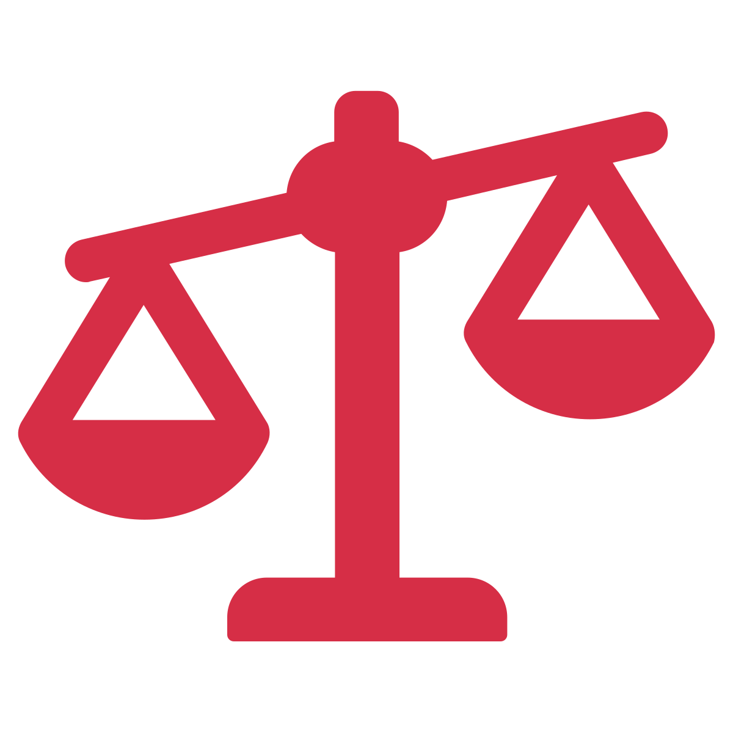
What is Bullying?
Destructive relationship
Power imbalance
Repeatedly aggressive with intent to harm
Notes:
In Canada, at least 1 in 3 teens report being bullied. When we say bullying, we are talking about [CLICK] a destructive relationship [CLICK] where one person or a group of people holds power over another, and [CLICK] intentionally acts aggressively to harm them. This is often done repeatedly. Bullying can happen in person or online.

Slide 4
Identity-Based Bullying
Bullying that targets people based on their identities.
Gender
Sexual orientation
Race
Ethnicity
Nationality
Body size
Class
Disability
Notes:
Today we’ll be talking about identity-based bullying, which refers to [CLICK] bullying that targets people based on their identities. For example, calling someone hurtful names because they are gay, excluding someone because they are of a different race, or catcalling someone because they’re a girl.

Slide 5
Identity-based Bullying
Power imbalance
Power = ability to impact lives of others
Created by society
Notes:
Bullying happens when there is a difference in power between two people or a group of people. Someone has power when they have the ability to act in ways that can impact the lives of others.
The differences in power that are at the root of identity-based bullying have been created by society, by oppressing some groups and privileging others over time. As a result, some groups in society continue to have more power as compared to others (for example, heterosexual youth hold more social power than queer youth, because society gives more social power to heterosexual people).

Slide 6
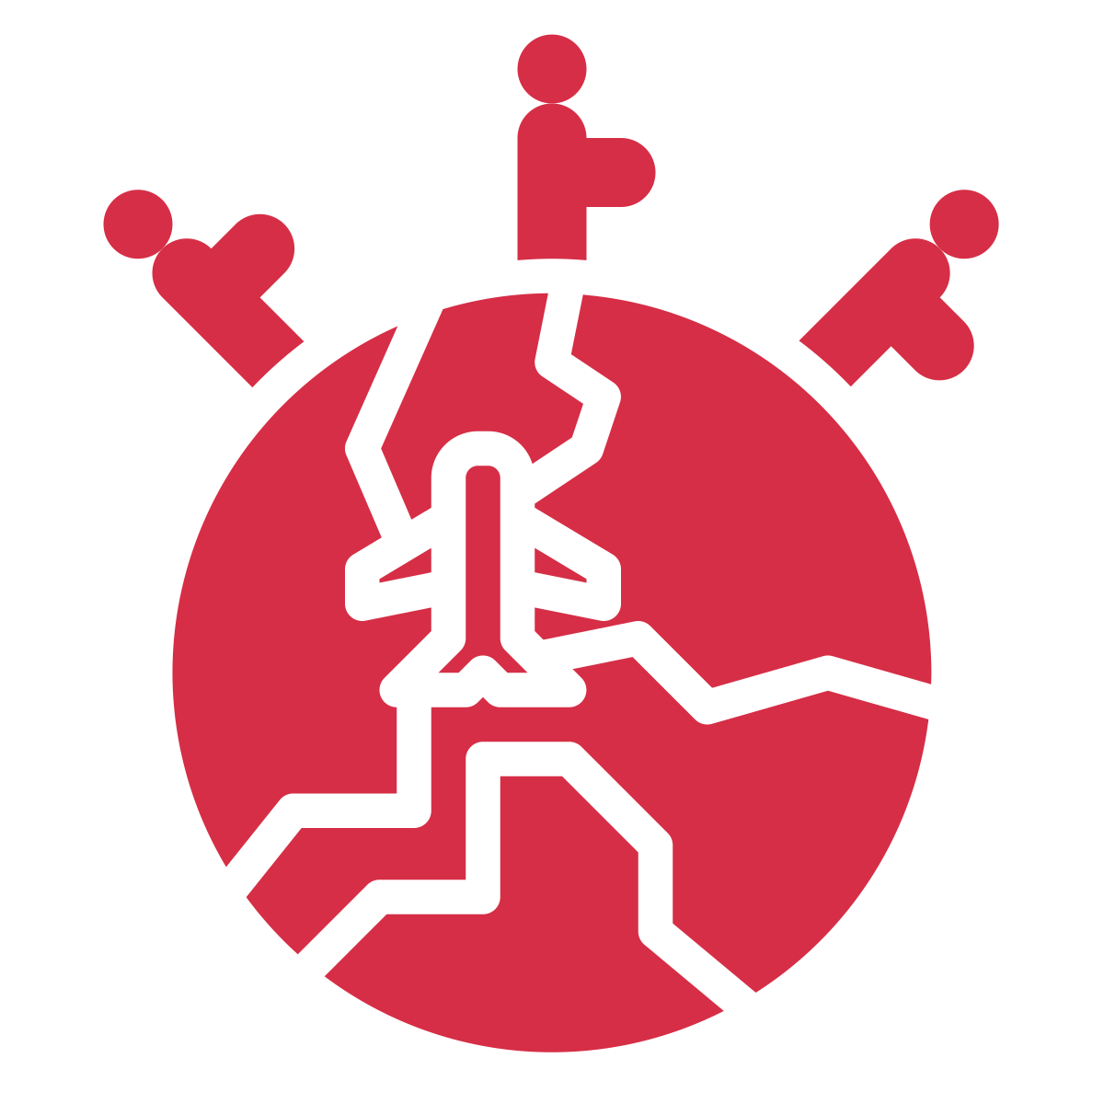
2SLGBTQIA+
Immigrant
Ethnic Minority
Notes:
Some of the groups of students who are often bullied for who they are include youth who identify as 2SLGBTQIA+ (which stands for Two-Spirit, Lesbian, Gay, Bisexual, Transgender, Queer or Questioning, Intersex, Asexual, and additional sexual orientations and gender identities – also referred to as gender and sexual minority youth), as an immigrant, or as an ethnic minority. Of course, many other students experience identity-based bullying as well, but today we will focus on these three.

Slide 7
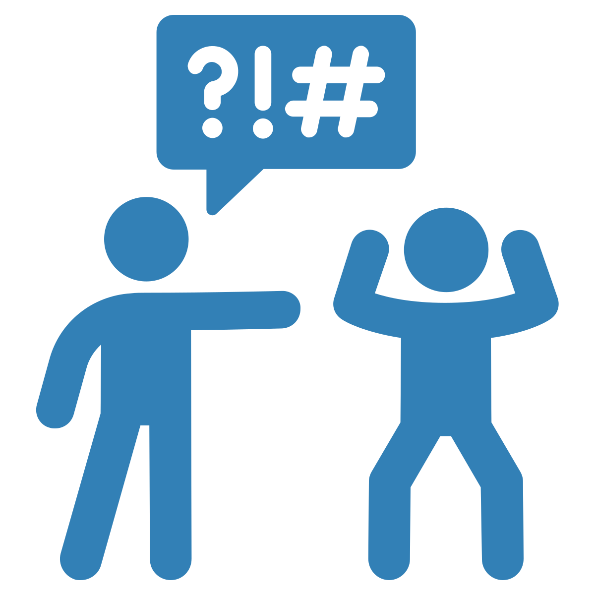
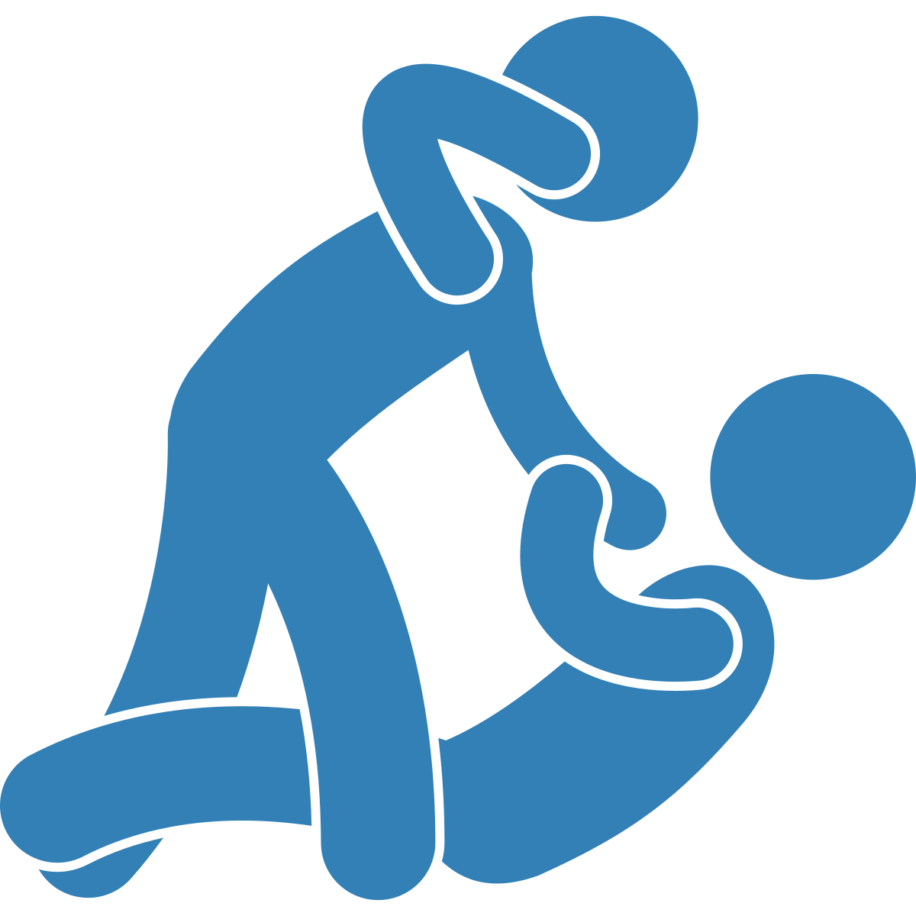
Notes:
Among gender and sexual minority youth, it is common to experience both [CLICK] verbal and physical harassment more often than those who identify as non-2SLGBTQIA+. According to the First National Climate Survey on Homophobia in Canadian Schools, about 60% of 2SLGBTQIA+ youth have experienced verbal harassment about their sexual orientation as compared to 6.8% for heterosexual youth. These high rates of bullying are especially troubling when we consider that gender and sexual minority youth report that the bullying they experience has led them to feel unsafe at school and uncomfortable being themselves. Gender and sexual minority youth are targeted for identity-based bullying because of larger societal beliefs that are prejudiced against gender diverse people and sexually diverse people.
The identity-based bullying that happens at the school level towards sexual and gender diverse youth is reflective of larger power differences in society, and the enforcement of these societal beliefs within the school building.

Slide 8
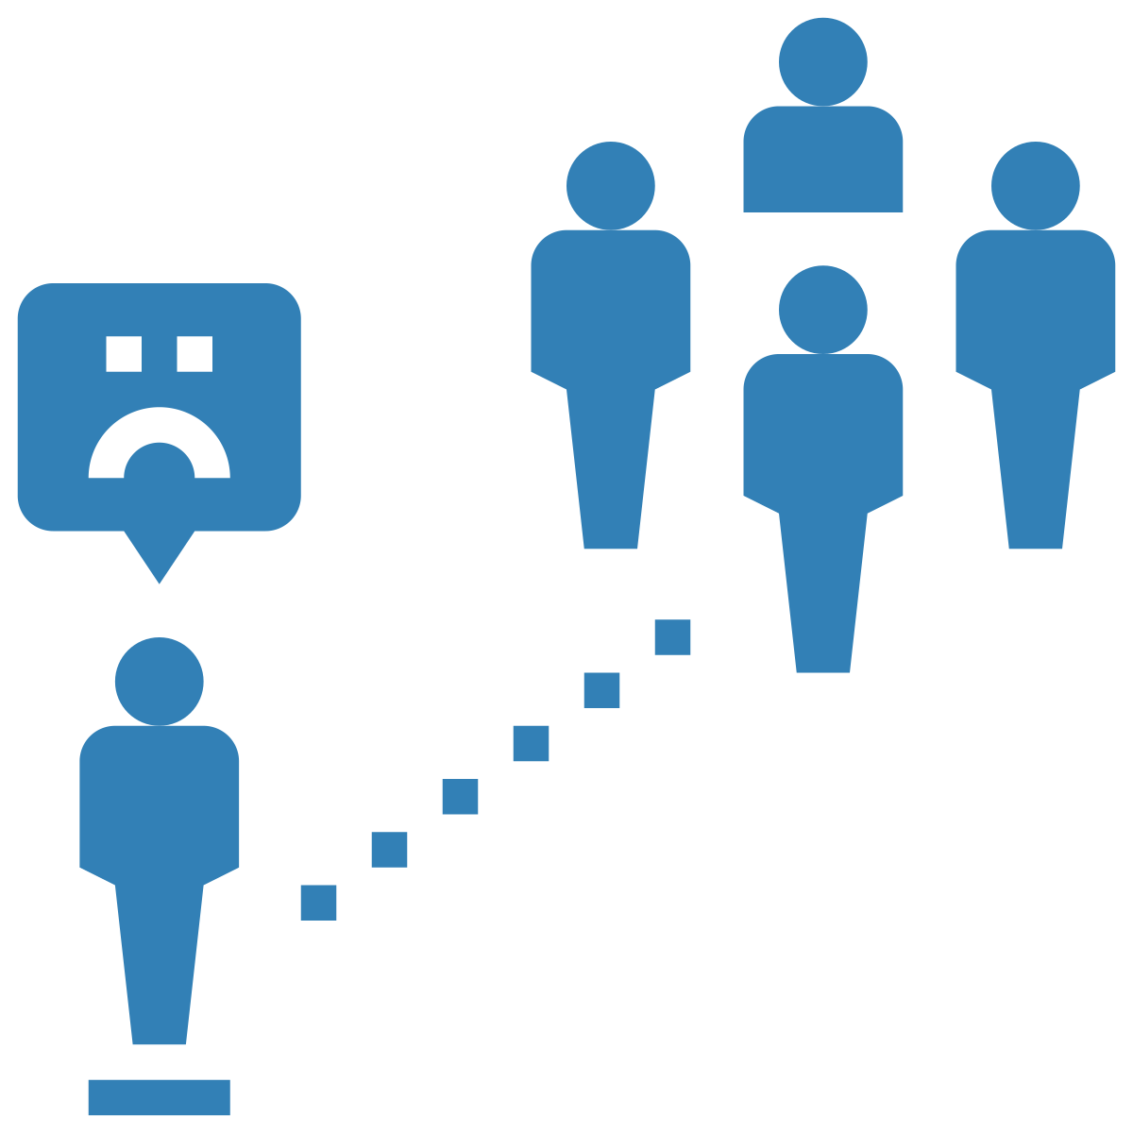
Notes:
For youth who have recently moved to Canada from another country, bullying is also quite common. According to a study conducted in 2017 by Vitoroulis and Georgiades, about 15% of Canadian youth who were born outside of Canada have experienced bullying specifically because of their race or ethnicity.
It also tends to be more common for immigrant youth to experience bullying if their school has fewer immigrant students, meaning that identity-based bullying is more likely to occur when they are in a minority status at school as well. Newcomer and immigrant youth are targeted for identity-based bullying because of the larger structural root cause of xenophobia (which is the dislike of, or prejudice against people from other countries). Again, the identity-based bullying that happens at the school level towards newcomer and immigrant youth is reflective of and enforces larger power differences in society.

Slide 9
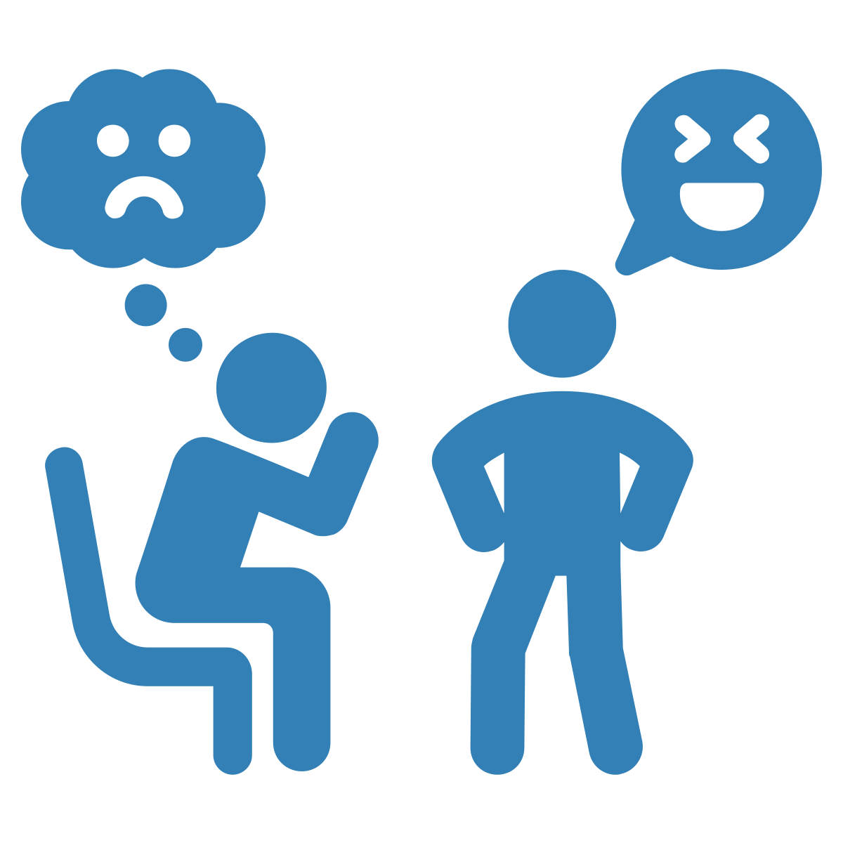
Notes:
Much like immigrant students, youth who are a visible ethnic minority, such as identifying as Black or Asian, experience bullying because of their race or ethnicity. According to a study conducted by the Angus Reid Institute in 2021, 26% of visible minority youth reported experiencing racially based bullying. Racialized youth are targeted for identity-based bullying because of the larger structural root cause of racism.

Slide 10
Notes:
These are just a few examples, but many other kinds of identity-based bullying can be experienced by youth. For example, identity-based bullying can target people based on their body size, class, disability, and many more.
Although it is important to recognize that certain groups of youth are targeted for identity-based bullying (like queer youth), we should not treat them primarily as youth in need of protection. Instead, we need to also honour their strengths, talents, and interests. This ensures we see them as full people. Also, we need to give these youth spaces where they can find solidarity for both struggles and joys.

Slide 11
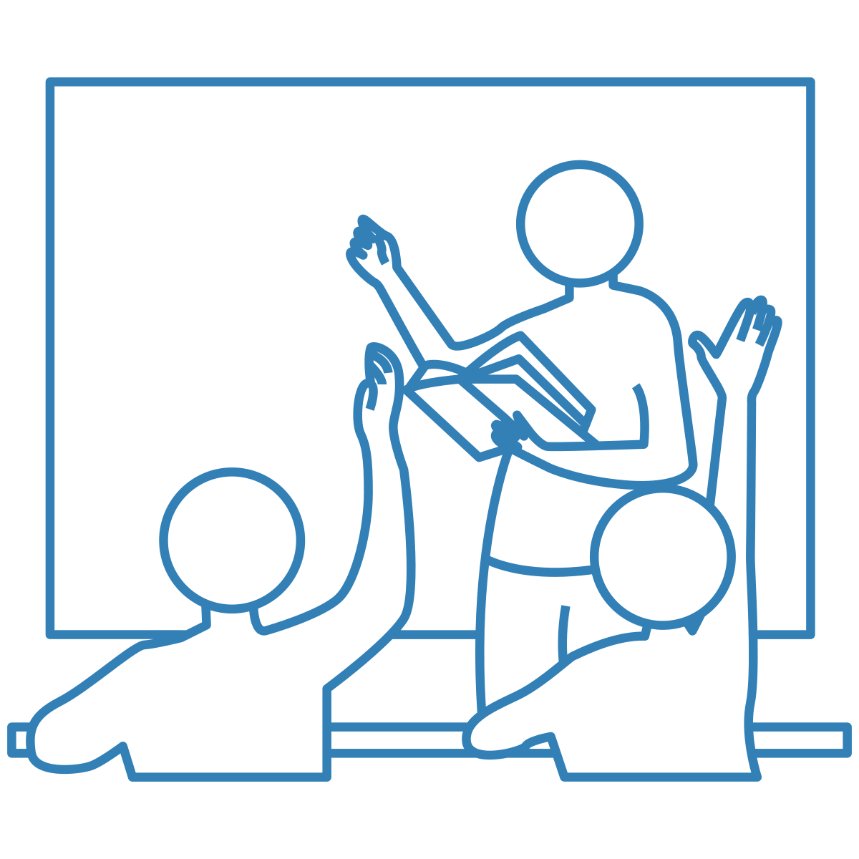
BIAS
Notes:
As educators, we are in an ideal position to identify identity-based bullying and then intervene in an appropriate way. One way we can support students is by learning about biases [CLICK], and how they play an important role in preventing identity-based bullying.

Slide 12
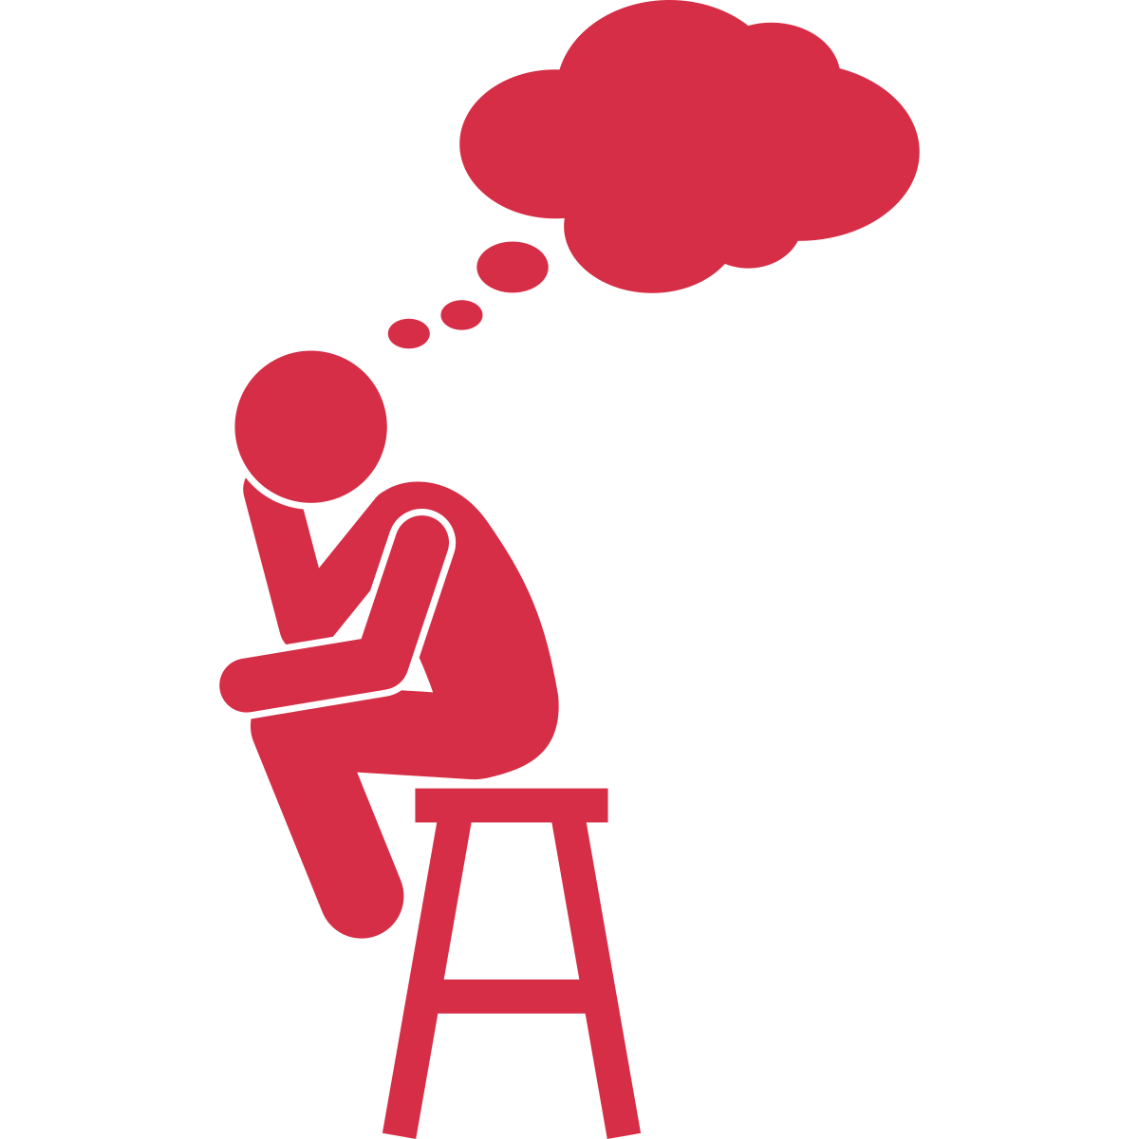
Notes:
A bias is an automatic judgement, or an inner thought people can have without even being aware of it. Typically, these inner thoughts happen when someone encounters a person who is different from them. They are shortcuts our brains take to help us process information quickly, and they are influenced by the things we have learned and experienced throughout our lives. For example, things we have seen in movies or things our families and peers have told us.

Slide 13
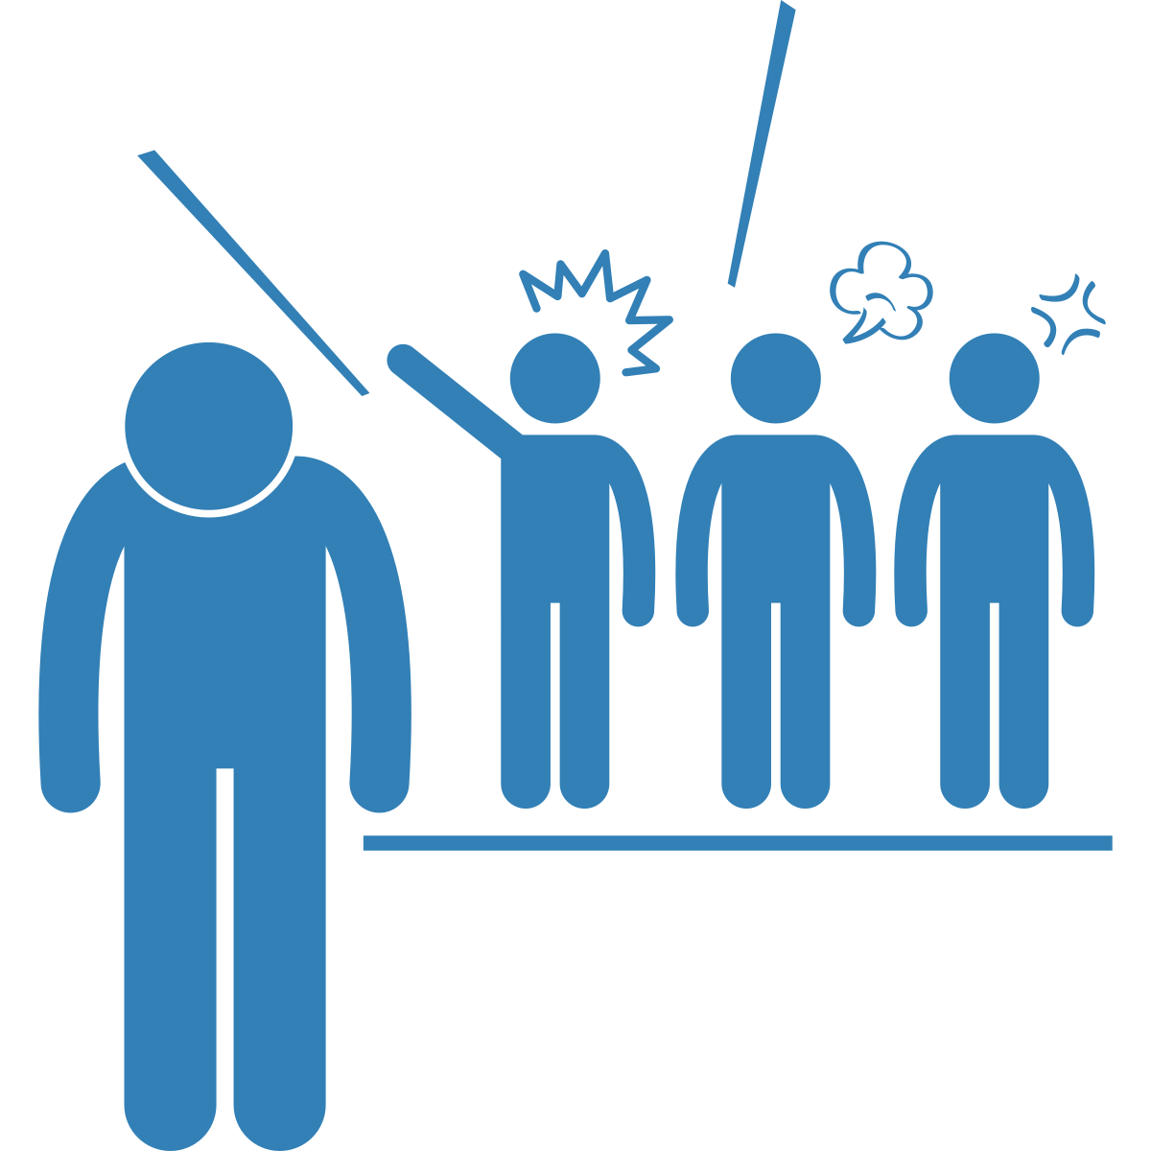
Notes:
Unfortunately, these shortcuts can be harmful because they can lead us to incorrect conclusions about others, and as a consequence, we end up treating them differently, which is “discrimination”. Learning about our automatic thoughts is important because they guide our attitudes, beliefs, and behaviors.

Slide 14
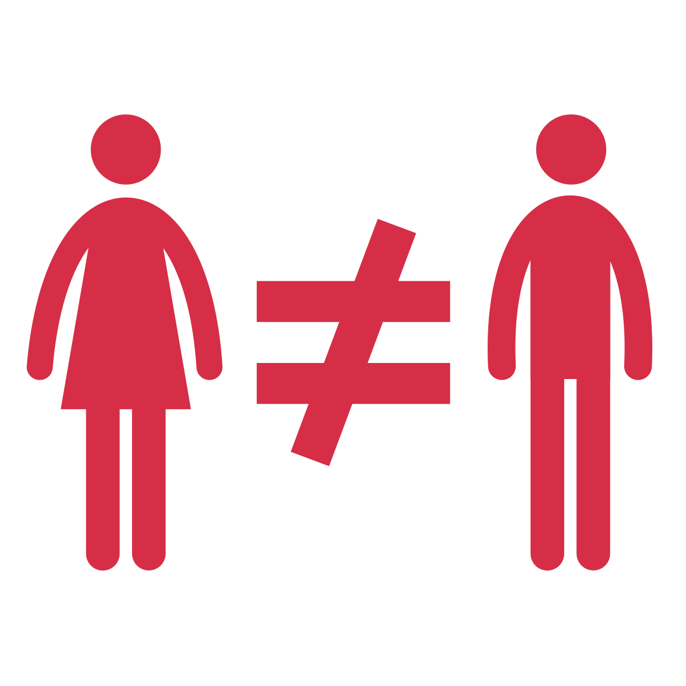
Notes:
As an example, think about common stereotypes in popular culture around gender. We often hear things like: girls are more sensitive than boys, girls are nicer than boys.
These discriminatory attitudes lead us to believe that people have to act a certain way based on the groups they belong to -so in this example, how people should behave based on gender. When we have these beliefs, we treat people differently based on whether they’re a girl, boy, trans, or non-binary.

Slide 15
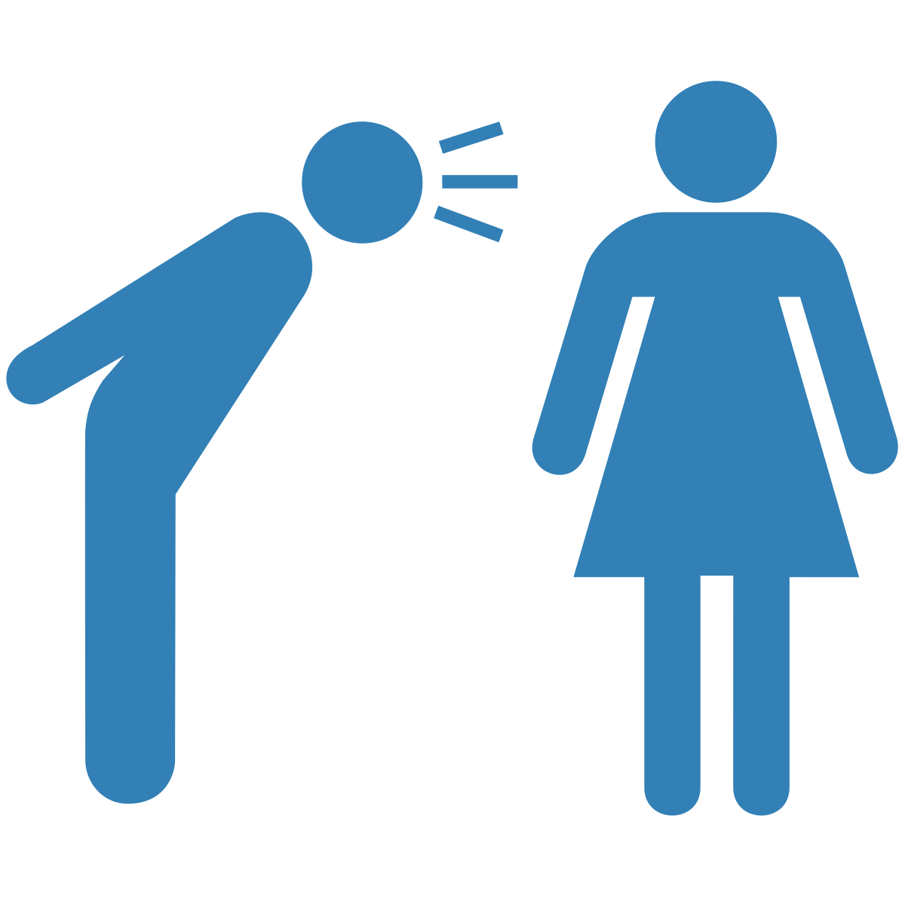
Notes:
For example, imagine this scenario: a White boy in Mr. Avery’s class calls a White girl mean names because she came out a lesbian, causing her to cry. Mr. Avery sees this as bullying and sends him to the principal’s office.

Slide 16
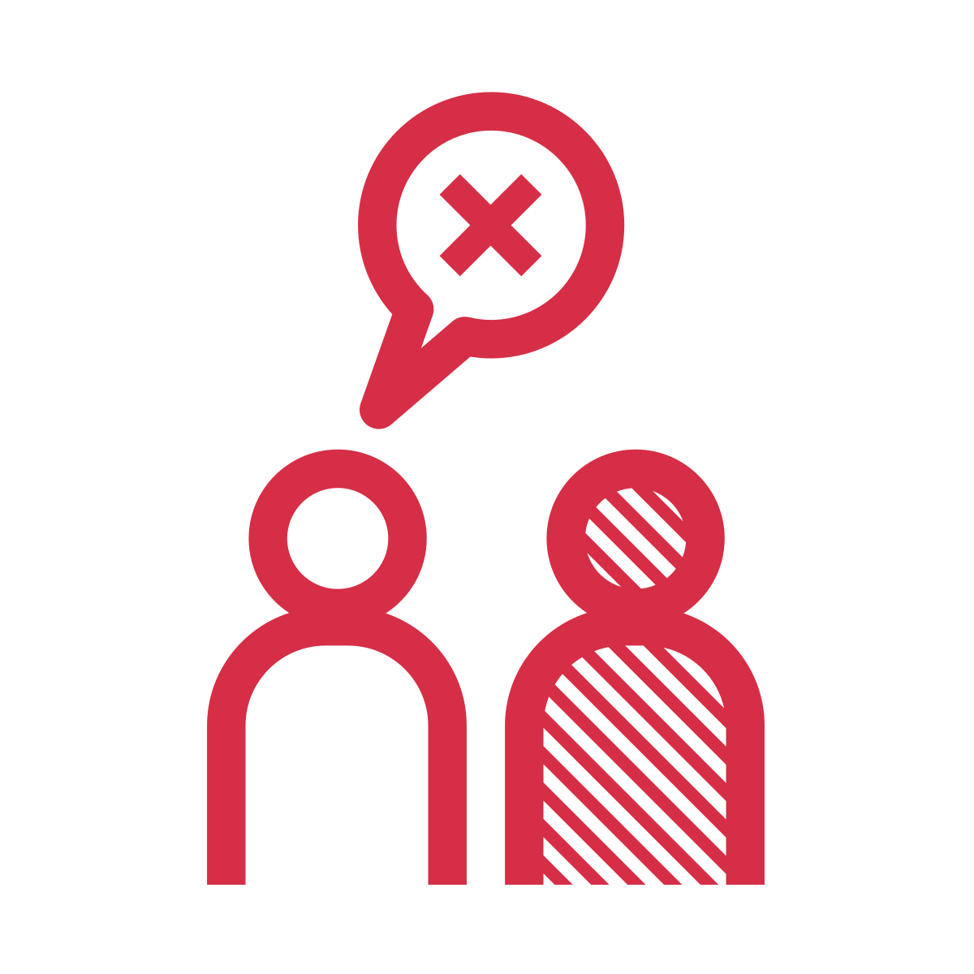
Notes:
Compare this to another scenario: a White girl in Mr. Avery’s class starts calling a Black boy mean names for having dark skin. The boy doesn’t really seem to react. Mr. Avery believes that the boy is strong and tough, and that the girl probably doesn’t mean to cause any harm because she’s likely only teasing. As a result, Mr. Avery ignores the behaviour and doesn’t intervene.

Slide 17
Notes:
In both scenarios, someone was experiencing identity-based bullying (in the first example, based on sexuality, and in the second, based on skin colour). But Mr. Avery only intervened in the first scenario. This was likely due to his own biases. In the first scenario, he believed that the girl needed care and support, and that because she cried, it was probably more serious. In the second scenario, he believed that the boy should have been tough enough to deal with the comments, especially as a Black boy, and that because he didn’t show any response, he was probably fine.
However, in both situations, Mr. Avery should have intervened. Both times, one student was using identity-based bullying, and both times it was serious and harmful. Unfortunately, Mr. Avery’s own biases affected his response. All youth deserve our help regardless of their gender or race, or if they seem affected by the bullying.
So, learning about our own biases is important because bias lays the groundwork for the discriminatory attitudes and beliefs that can affect how we respond to identity-based bullying.

Slide 18
The Iceberg Concept of Culture
Spoken Rules
Surface Culture
Language
Dress
Unspoken Rules
Deep Culture
Beliefs
Assumptions
Notes:
But how do we learn to become aware of our biases? One way is to learn about the "iceberg" concept of culture. The iceberg identifies our culture's spoken and unspoken rules. Above the surface [CLICK] are our spoken rules, like what we say and how we dress. Spoken rules shape our attitudes and beliefs and influence how we think about people and how we interact with them. Unspoken rules [CLICK] are beneath the surface and are sometimes hard to see. Unspoken rules are often referred to as social norms because they define what is considered typical within a broader cultural context. However, just because it is considered typical does not mean it is useful or helpful for supporting healthy relationships, as in the case of identity-based bullying.
Remember, we learn these norms, or cultural rules, through interacting with family, friends, and in our communities over our lifetime. These rules affect how we treat individual students in our classroom, even if we don’t mean to. However, once we know about them, it is our responsibility to start to address them.

Slide 19
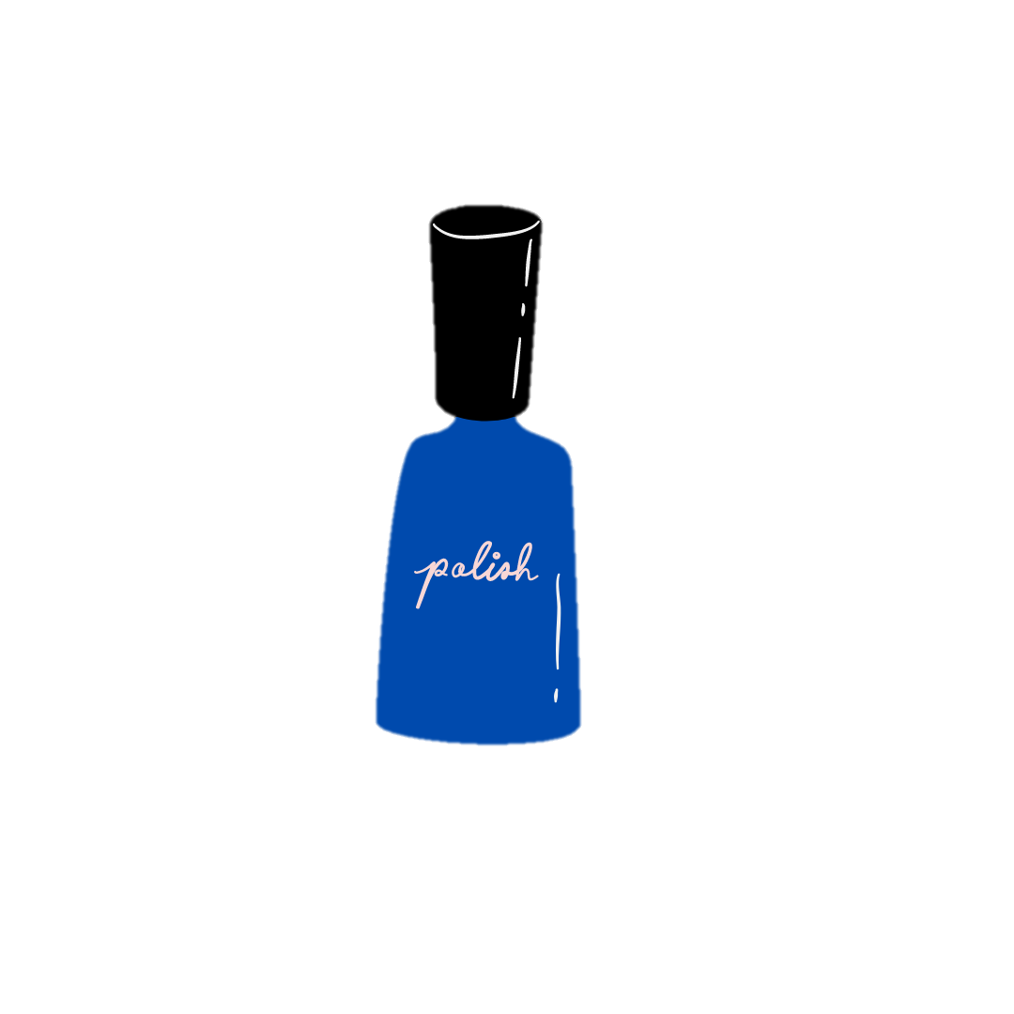
Social Norms
Notes:
As another example, think about which of your students wears nail polish. The unspoken rules [CLICK] deep in our culture (the part of the iceberg beneath the surface) that say that nail polish is only for girls can lead you to think [CLICK] only female students are allowed to wear nail polish (the social rules above the surface).
But, the idea that only girls should wear nail polish is by no means universal, and is based on what are called cisnormative beliefs about what is ‘okay’ for different genders to do and not do. If people’s actions don’t align with these beliefs – like in the case of boys who wear nail polish – they are socially punished (such as through identity-based bullying) for not conforming. Because these social rules are buried so deep below the surface, we may be doing the action (judging a boy for wearing nail polish) without realizing why we are doing it (because society expects people to behave in cisnormative ways).

Slide 20
Notes:
As is probably not surprising, these types of norms are very restrictive, and do not support people to be who they really are. As such, when they are enforced through our thoughts, statements, or actions, they can lead to harm for students whose identity doesn’t fit these norms, such as boys or gender diverse students who wear nail polish.
Even though we may think that the way we understand nail polish is typical, if we do not understand the source of this belief and address it within ourselves and our classrooms, we can cause harm to students who do not follow this social rule. In other words, when teachers haven’t reflected on their biases, they may unintentionally pass on harmful attitudes to their students, creating a classroom environment where discrimination can occur and is left unquestioned. In this example, we would be unintentionally creating an environment where it is acceptable to bully someone because they choose to wear nail polish as a boy.

Slide 21
Notes:
Imagine an educator who believes that [CLICK] some people are “not supposed to wear nail polish”. Now imagine that educator sees a boy in his class get bullied for wearing nail polish. If that educator thought his student shouldn’t be wearing nail polish in the first place, the educator may then think “well of course that student was going to be made fun of”. When this happens, it’s called victim blaming, where people hold the person being bullied responsible. Victim blaming also leads to a lot of harm for the student being bullied.

Slide 22
1
It is important to identify and recognize our biases.
2
We must work to unlearn biases.
3
We can prevent harmful attitudes from being passed onto students.
What We
Now Know!
4
Helps us to prevent identity-based bullying.
Notes:
In summary, [CLICK] it is important to identify and recognize our biases. Once we can recognize and identify our biases, [CLICK] we can then work to unlearn them. By working to undo our biases, [CLICK] we can prevent these harmful attitudes from being passed onto the students in our classroom, and [CLICK] be an active part of preventing identity-based bullying in our school.

Slide 23
Thank you to partners and collaborators!
Financial contribution from Ontario Ministry of Education

